Slide 1
Optimal Management Atrial Fibrillation 2010

Slide 2
Atrial Fibrillation
First described by Sir William Harvey in 17th century:
observed chaotic motion of atria in open chest animal
ECG findings described in 1909 by Sir Thomas Lewis:
“irregular or fibrillatory waves and irregular ventricular response” or “absent atrial activity
with grossly irregular ventricular response”

Slide 3
Atrial Fibrillation

Slide 4
Incidence and Prevalence of Atrial Fibrillation
Age (Yrs) | Manitoba F/U Study |  | Framingham
 | Prevalence | Incidence | Prevalence | Incidence
20 | 0 | 0 | - | -
30 | 0 | 0 | - | -
40 | 1.1 | 0.3 | 0.4 | 0
50 | 5.1 | 0.7 | 0.8 | 0.4
60 | 18.0 | 3.5 | 1.9 | 0.9
70 | 54.4 | 8.6 | 9.1 | 4.5
80 | 92.7 | 16.3 | 21.9 | 12.5
90 | 105 | - | - | -
Incidence per 100,000 patient years. Prevalence per 1000,000 patients

Slide 5
Hospital admissions in the USA

Slide 6
Clinical Classification of AFib
First episode
Symptomatic or asymptomatic
Self limited or persistent
Recurrent Afib
2 or more episodes lasting > 30 seconds
Paroxysmal Afib
Recurrent Afib that ends spontaneously
Persistent Afib
Afib that requires pharmacotherapy or cardioversion for termination (may be 1st episode or recurrent)
Permanent Afib
Longstanding Afib in which cardioversion has failed or not been indicated

Slide 7
Atrial Fibrillation
If unstable  Cardiovert
Angina
Congestive heart failure
Hemodynamic compromise
Synchronized DC Cardioversion
Initial energy 150 Joules biphasic or 200 J monophasic

Slide 8
AFIB-If clinically stable
AFIB duration < 48 hours
consider electrical or pharmacologic cardioversion
AFIB duration > 48 hours
rate control
anti-coagulate as per risk stratification
evaluate for elective cardioversion

Slide 9
If unstable  Cardiovert
If Stable:
Rate control
Minimize thrombo-embolic risk.
Establish etiology
Restore sinus rhythm
Maintain sinus rhythm

Slide 10
Pharmacologic Rate Control
GOALS:
Improve symptoms
Avoid excessive bradycardia/hypotension from IV rate controlling medications
Control of ventricular rate chronically to prevent tachycardia induced cardiomyopathy

Slide 11
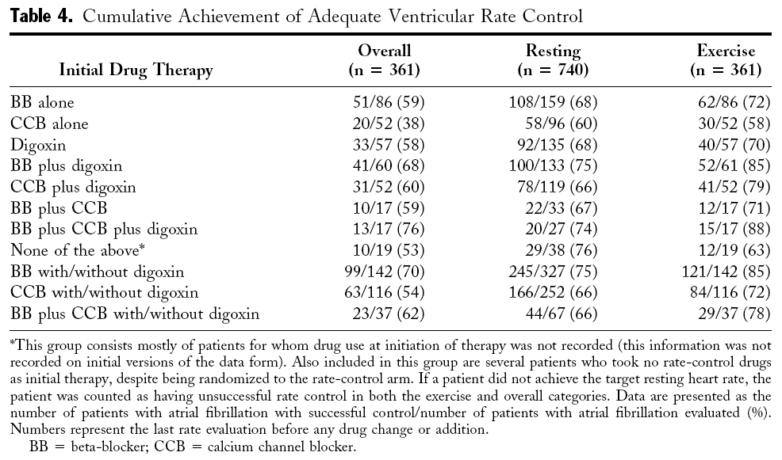
JACC 2004:43;1201-1208.

Slide 12
Pharmacologic Rate Control - 2
Non-dihydropyridine CCB (verapamil, diltiazem), or β-blocker as initial rate control in young active patients [CCS Level I-B]
β-blocker plus Digoxin in patients with CHF, [CCS Level I-C]
Consider combination therapy to:
minimize side effects
maximize resting and exertional HR control
improve symptoms and functional capacity [CCS Level IIa-C]

Slide 13
Pharmacologic Rate Control - 3
Adjust digoxin dose ↓ if combined with verapamil/amiodarone
Digoxin may be used for initial rate control in the elderly or inactive [CCS Level IIa-C]
Consider Amiodarone for rate control if CHF/LV dysfunction

Slide 14
Atrial Fibrillation Rate Control (IV or PO)
Metoprolol:
5mg IV q5min X 3→5-10 mg IV q6h
PO 25-100 mg BID
Verapamil:
5-15 mg IV→0.05-0.2 mg/min IV
PO 80-120 mg TID
Diltiazem:
0.25 mg/kg IV over 2 minutes→5-15 mg/hr IV
PO 30-90 mg QID
Digitalis: Use as adjunct for rate control
0.25 mg PO or IV q4h X 3 doses→ 0.125-0.5d mg/d*
Adjust dose based on body size and renal function

Slide 15
Atrial Fibrillation IV Rate Control
Drugs for IV Rate Control | Loading Dose | Onset minutes | Maintenance dose | Side Effects | Class of Recommendation
Diltiazem | 0.25 mg/kg IV over 2 min | 2-7 | 5-15 mg/hr infusion | Hypotension, Heart block, HF | I
Esmolol | 0.5 mg/kg over 1 min | 5 | 0.05-0.2 mg/kg/min | Hypotension, Heart block, HF, Bradycardia, Asthma | I
Metoprolol | 2.5 to 5 mg IV over 2 min q 5 min;up to 3 doses | 5 | NA |  | I
Propranol | 0.15 mg/kg IV | 5 | NA |  | I
Verapamil | 0.15 mg/kg IV over 2 min | 3-5 | NA | Hypotension, Heart block, HF | I
Digoxin | 0.25 mg IV each 2 h, up to 1.5 mg | 2 hours | 0.0625-0.25 mg/day | Heart block, Bradycardia, Dig toxicity | IIB

Slide 16
Drugs for Oral Rate Control | Loading Dose | Onset | Maintenance Dose | Side effects | Class of Recmmend- ation
Digoxin | 0.25 mg PO each 2 h; up to 1.5 mg | 2 h | 0.0625-0.375 | Dig toxicity, Heart block, Bradycardia | I
Diltiazem | NA | 22-4 | 120-360 mg daily | Hypotension, Heart block, HF | I
Metoprolol | NA | 4-6 | 25-100 mg BID | Hypotension, Heart block, HF, Bradycardia, Asthma | I
Propranol | NA | 60-90 min | 80-240 mg daily/divided doses |  | I
Verapamil | NA | 1-2 hours | 120-480 mg daily/divided doses | Hypotension, Heart block, HF, Dig interaction | I
Amiodarone | 800 mg/dX1wk 600 mg/dX1wk 400 mg/d X 4-6 wk | 1-3 weeks | 200 mg/day | Lung toxicity, skin discoloration, ↓↑ T4 corneal deposits,optic neuropathy,warfarin & digoxin interaction,proarrhythmia (IIB)

Slide 17
If unstable  Cardiovert
If Stable:
Rate control
Minimize thrombo-embolic risk.
Establish etiology
Restore sinus rhythm
Maintain sinus rhythm

Slide 18
Modifiable Risk Factors in Stroke
Risk Factor | Relative Risk | Prevalence (%)
Atrial Fib* | 5.6-17.6 | 1
Hypertension | 4.0-5.0 | 25-40
Cardiac Disease | 2.0-4.0 | 10-20
Diabetes | 1.5-3.0 | 4-8
Smoking | 1.5-2.9 | 20-40
Alcohol Abuse | 1.0-4.0 | 5-30
Hyperlipidemia | 1.0-2.0 | 6-50
Prevalence varies by age, gender, race, ethnicity and stroke risk factor
* AF has the highest relative risk Adapted from Sacco RL. Neurology 1995;45(Suppl 1):S10-S14.

Slide 19
Atrial Fibrillation Decision Aide

Slide 20
Risk Stratification for Stroke : Revised CHADS₂ Index

Slide 21
Risk of Stroke/Year Based on Revised CHADS₂ Index

Slide 22
2009 Birmingham Schema CHA₂DS₂-VASc
Gregory Y. H. Lip, Robby Nieuwlaat, Ron Pisters, Deirdre A. Lane and Harry J. G. M. Crijns. Refining Clinical Risk Stratifion for Predicting Stroke and Thromboembolism in Atrial Fibrillation Using a Novel Risk Factor-Based Approach : The Euro Heart Survey on Atrial Fibrillation. Chest 2010;137;263-272.

Slide 23
Stroke or Other TE at 1 Year Based on the 2009 Birmingham (CHA2DS 2-VASc):
Theoretical TE rates without therapy: corrected for the % of patients receiving aspirin within each group, assuming that aspirin provides a 22% reduction in TE risk, based on Hart et al. Ann Intern Med . 2007 ; 146 ( 12 ): 857 - 867 .

Slide 24
Atrial Fibrillation Decision Aide

Slide 25
Atrial Fibrillation and Structural Heart Disease:
Patients with atrial fibrillation and structural heart disease are at high risk for stroke and should be on some form of oral anticoagulation:
Hypertensive heart disease
Coronary heart disease with LV dysfunction,
Rheumatic valvular heart disease
Congenital valvular heart disease (bicuspid aortic valve with aortic stenosis, mitral valve prolapse)
Hypertrophic cardiomyopathy (obstructive or non-obstructive)
Idiopathic dilated cardiomyopathy
Complex congenital heart disease

Slide 26
Atrial Fibrillation Decision Aide

Slide 27
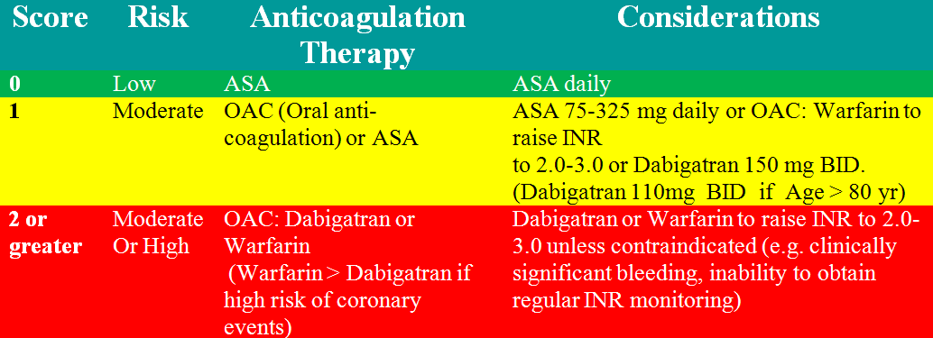
Antithrombotic Recommendations
Eighth (2008) ACCP Guidelines for Antithrombotic Therapy for Prevention and Treatment of Thrombosis
(CHEST 2008; 133 (6), supplement) and CCS 2010 Atrial Fibrillation Guidelines

Slide 28
Evaluate Risk of Bleeding
H = SBP > 160
A = Dialysis, Renal Tx or Cr > 200 mmol/L
B = Previous bleeding, bleeding diathesis or anemia
L = unstable/high INRs or < 60% time in therapeutic range
D = Anti-platelet agents, NSAIDS

Slide 29
HAS-BLED Score

Slide 31
Narrow therapeutic range with VKA
Target INR
(2.0-3.0)
Ischaemic stroke
Intracranial haemorrhage
80
60
The anticoagulant effect of vitamin K antagonists are optimized when therapeutic doses are maintained within a very narrow range
Events / 1000 patient years
40
20
0
<1.5
1.5–1.9
2.0–2.5
2.6–3.0
3.1–3.5
3.6-4.0
4.1-4.5
>4.5
1. Hylek EM, et al. N Eng J Med 2003; 349:1019-1026.
International Normalised Ratio (INR)
Notes:
The anticoagulant effect of VKAs are optimized when therapeutic doses are maintained within a very narrow range.
Over-anticoagulation (INR >3) can lead to an increased risk of bleeding and under-anticoagulation (INR <2) can lead to increased risk of stroke.

Slide 32
INR control: clinical trials v. clinical practice
INR* control in clinical trial versus clinical practice (TTR**)
66%
Clinical trial¹
Clinical practice²
44%
38%
% of eligible patients receiving warfarin
25%
18%
9%
<2.0
2.0 – 3.0
>3.0 INR
*INR = International normalized ratio
** TTR = Time in Therapeutic Range (INR2.0-3.0)
1. Kalra L, et al. BMJ 2000;320:1236-1239 * Pooled data: up to 83% to 71% in individualized trials; 2. Matchar DB, et al. Am J Med 2002; 113:42-51.
Notes:
Time in Therapeutic Range (TTR) of 2.0-3.0 with VKA tends to be highest (60–70%) in well-controlled environments, e.g. clinical trials¹
INR control tends to be much lower in clinical practice.
In a retrospective review in clinical practice setting: relative risk reduction of stroke was only 38% (Rietbrock et al. Thromb Haemost. 2009; 101: 527-534)

Slide 33
The RE-LY® Study: Randomized Evaluation of Long-term anticoagulant therapY
Dabigatran Compared to Warfarin in 18,113 Patients with Atrial Fibrillation at Risk of Stroke
Connolly SJ., et al. NEJM published online on Aug 30th 2009. DOI 10.1056/NEJMoa0905561
Dabigatran etexilate is in clinical development and not licensed for clinical use in stroke prevention for patients with atrial fibrillation
Notes:
33

Slide 34
RE-LY® – study design
Atrial fibrillation with ≥ 1 risk factor
Absence of contraindications
R
Warfarin
1 mg, 3 mg, 5 mg
(INR 2.0-3.0)
N=6000
Dabigatran etexilate
110 mg bid
N=6000
Dabigatran etexilate
150 mg bid
N=6000
Primary objective: To establish the non-inferiority of dabigatran etexilate to warfarin
Minimum 1 year follow-up, maximum of 3 years and mean of 2 years of follow-up
Ezekowitz MD, et al. Am Heart J 2009;157:805-10.
Connolly SJ., et al. NEJM published online on Aug 30th 2009. DOI 10.1056/NEJMoa0905561
Dabigatran etexilate is in clinical development and not licensed for clinical use in stroke prevention for patients with atrial fibrillation
Notes:
Statistical testing in the RE-LY Study:
Primary endpoint:
Non-inferiority design allowing for statistical analysis of superiority once non-inferiority is achieved
All other endpoints:
Superiority testing.
P < 0.05 → superior (95% CI is below 1)
P > 0.05 → comparable (if 95% CI includes 1)

Slide 35
Stroke or systemic embolism (SSE)
Noninferiority
Superiority
p-value
p-value
Dabigatran 110 mg
vs. warfarin
<0.001
0.34
Dabigatran 150 mg
vs. warfarin
<0.001
<0.001
Margin = 1.46
0.50
0.75
1.00
1.25
1.50
HR (95% CI)
Connolly SJ., et al. NEJM published online on Aug 30th 2009. DOI 10.1056/NEJMoa0905561
Dabigatran etexilate is in clinical development and not licensed for clinical use in stroke prevention for patients with atrial fibrillation
Notes:
Both dosages of dabigatran etexilate met the non-inferiority criteria (p value < 0.001). The upper limit of the confidence intervals for dabigatran etexilate 110 mg BID was far below the non-inferiority margin of 1.46. Dabigatran 150 mg BID demonstrated superiority with the point of estimate and 95% CI well below the line of unity and a p-value of < 0.001 (superiority).

Slide 36
Time to first stroke / SSE
RR 0.91
(95% CI: 0.74–1.11)
p<0.001 (NI)
p=0.34 (Sup)
0.05
0.04
RRR
34%
Warfarin
Dabigatran etexilate 110 mg
Dabigatran etexilate 150 mg
0.03
Cumulative hazard rates
RR 0.66
(95% CI: 0.53–0.82)
p<0.001 (NI)
p<0.001 (Sup)
0.02
0.01
0.0
0
0.5
1.0
1.5
2.0
2.5
Years
RR, relative risk; CI, confidence interval; NI, non-inferior; Sup, superior
Connolly SJ., et al. NEJM published online on Aug 30th 2009. DOI 10.1056/NEJMoa0905561
Dabigatran etexilate is in clinical development and not licensed for clinical use in stroke prevention for patients with atrial fibrillation

Slide 37
RE-LY® in perspective
Meta-analysis of ischaemic stroke or systemic embolism
Category
W vs placebo
W vs W low dose
W vs ASA
W vs ASA + clopidogrel
W vs ximelagatran
W vs dabigatran 150
0
0.3
0.6
0.9
1.2
1.5
1.8
2.0
Favours warfarin
Favours other treatment
Dabigatran etexilate is in clinical development and not licensed for clinical use in stroke prevention for patients with atrial fibrillation
Camm J.: Oral presentation at ESC on Aug 30th 2009.

Slide 38
If unstable  Cardiovert
If Stable:
Rate control
Minimize thrombo-embolic risk.
Establish etiology
Restore sinus rhythm
Maintain sinus rhythm

Slide 39
Cardiovascular Diseases
Hypertension
CHF
Valvular Heart Disease
CAD-with LV dysfunction
Cardiomyopathy
Dilated
Hypertrophic
Congenital Heart Disease
ASD
Ebstein’s anomaly
Inflammatory disease
Pericarditis
Myocarditis
Metastatic Disease
Infiltrative
Amyloidosis
Degenerative

Slide 40
Correlation Between AFib and Heart Failure Severity

Slide 41
Potentially Reversible Causes of Atrial Fibrillation
Hypoxia
Acidosis
Electrolyte Abnormalities
Atrial stretch or tension
Autonomic influences
sympathetic stimulation
intense vagal stimulation
Hyperthyroidism
Toxins
Alcohol
CO
Infection
pneumonia
Inflammation
pericarditis
Post-operative
Cardiac Surgery
Thoracic surgery
Pulmonary disease
Pulmonary Embolism
Pneumonia
Exacerbation COPD
Electrocution

Slide 42
Neurogenic and Autonomically Mediated Atrial Fib
Heightened vagal tome
Heightened adrenergic tone
Anxiety
Pheochromocytoma
Exertion
Drugs
Sub-arachnoid hemorrhage

Slide 43
Atrial Fibrillation: Appropriate investigations
History and physical
12 lead ECG
Electrolytes, CBC, TSH
Echocardiogram
Baseline INR/PTT if anti-coagulation a consideration
CXR (selected patients)
Holter monitor
assess rate control
r/o bradycardia
TMT
assess rate response
r/o ischaemia

Slide 44
Atrial Fibrillation: Echocardiographic Evaluation
LV function (EF),chamber size,wall motion
Segmental dysfunction-coronary disease
MS-severity, valve area
AS- valve gradient, valve area
AR/MR severity
TR- RV systolic pressure = PA pressure
RV function
R/O IHSS, HCM
R/O Pericardial Disease
R/O rare causes e.g. myxoma, infiltrative disorders- restrictive cardiomyopathy
Diastolic function
Hyperdynamic states

Slide 45
Role of TEE
Transesophageal Echocardiography to Assess Embolic Risk in Patients With Atrial Fibrillation. Stollberger et al. Ann Int Med 1998; Vol 128, No.8. Pages 630-638.

Slide 46
Predictors of CVA or Embolism
Univariate analysis
LA thrombi RR 1.4
Atrial appendage length 44 (43-45 mm) RR 1.6
Atrial appendage width 23 (22-23mm) RR 2.4
Multivariate analysis
Hypertension RR 3.6
Previous stroke RR 3.7
Age RR 1.1

Slide 47
Imaging LA Thrombus
TEE
CT

Slide 48
If unstable  Cardiovert
If Stable:
Rate control
Minimize thrombo-embolic risk.
Establish etiology
Restore sinus rhythm
Maintain sinus rhythm

Slide 49
Rate vs Rhythm Control
Favours rate control
Persistent Afib
Recurrent Afib
Less symptomatic
≥ 65 years of age
Male
Hypertension
No Hx of CHF
Previous rhythm Rx failure
Patient preference
Favours rhythm control
Paroxysmal Afib
First episode Afib
More Symptomatic
< 65 years of age
Female
No hypertension
Hx of CHF
No previous rhythm Rx
Patient preference

Slide 50
AFFIRM Trial
4060 patients with atrial fibrillation of less than 6 months duration
Rate control with digoxin, beta blocker or calcium channel blocker and anticoagulation with warfarin or
Rhythm control with the most effective anti-arrhythmic drug and anticoagulation with warfarin
Amiodarone 39% (60% at 3 years), sotalol 33%, other Rx 1-10%
Follow-up 3.5 years

Slide 51
AFFIRM Trial
Results:
No difference in all cause mortality (1° endpoint)
Trend towards better survival with rate control
No difference in death, ischaemic stroke, anoxic encephalopathy, major bleeding or cardiac arrest (2° endpoints)
No difference in quality of life or functional status including cardiovascular death, CHF, thromboembolism severe bleeding, pacemaker implantation or side effects of anti-arrhythmic therapy between the two strategies

Slide 52
RACE Trial
522 patients with persistent atrial fibrillation or atrial flutter (24 hours-1 year)
2 cardioversions within 1 year
Rate control to HR < 100 bpm and no symptoms
Rhythm control: Sotalol followed by Flecainide or Propafenone followed by Amiodarone
Primary endpoint: cardiovascular death, admission or CHF, Thromboembolic events, severe bleeding, pacemaker implantation or severe anti-arrhythmic side effects

Slide 53
RACE Trial
Results: non-significant trend to higher incidence of primary endpoint with rhythm control (22.6 versus 17.2%)
In patients with hypertension, rhythm control had a higher incidence of the primary endpoint (30.8 versus 12.5 % for rate control)

Slide 54
AFIB-If clinically stable
AFIB duration < 48 hours
consider electrical or pharmacologic cardioversion
AFIB duration > 48 hours
rate control
anti-coagulate as per risk stratification
evaluate for elective cardioversion

Slide 55
Pharmacologic Conversion
Ineffective drugs for conversion | Recommended drugs for conversion of atrial fibrillation
Digoxin | Ibutilide (IV) [CCS I-A]
Sotalol | Flecainide (PO) [CCS I-A]
Verapamil | Procainamide (IV)[CCS I-B]
Diltiazem | Propafenone (PO)[CCS I-B]
 | Chronic Amiodarone [CCS II-A]
 | Sotalol [CCS III-B]

Slide 56
Pharmacologic Conversion
Caution with Flecainide/Propafenone
Rate control first with an AV-nodal blocking agents as type I agents may accelerate conduction in Atrial fibrillation/flutter (1:1 conduction)
Class I agents should be AVOIDED in CAD and structural heart disease

Slide 57
Elective Cardioversion for Atrial Fibrillation
Ensure INR therapeutic ≥ 3 weeks
Synchronized DC Cardioversion
Initial energy 150 Joules biphasic or 200 J monophasic
Continue anti-coagulation at least 3-4 weeks post cardioversion
Risk stratify for long term anti-coagulation

Slide 58
Predictors of Atrial Fibrillation Recurrence
Age > 70
Afib duration > 3 months
Hypertension
Heart Failure
LA enlargement
Rheumatic heart disease

Slide 59
Maintenance of NSR
One year recurrence rate 75% in absence of anti-arrhythmic drug
Higher risk of pro-arrhythmia with underlying structural heart disease
Amiodarone more efficacious than Dronedarone but significant side effects
Other agents have potential for pro-arrhythmia in patients with underlying heart disease

Slide 60
Maintenance of NSR in Patients with Structurally Normal Hearts
Dronedarone 400 mg BID
Flecainide§: 50-150 mg BID
Propafenone§: 150 mg BID-TID
Sotalol*:80-160 mg BID (dose should be adjusted for renal function and Q-Tc during in-hospital initiation phase)
Amiodarone: 200 mg OD-BID (load 600mg/day X 1 mo or 1000mg/day X 1 week)
β- blockers: moderately effective in maintaining NSR (Metoprolol, Atenolol, Bisoprolol)
Alternative:
Disopyramide§
Dofetilide **
§ Avoid with structural heart disease, CAD or LV dysfunction
*Contra-indicated in women > 65 on diuretics (risk of Torsades de pointes)
** Dofetilide available through Health Canada special access program

Slide 61
Maintenance of NSR in Patients with Structurally Abnormal Hearts
CAD with normal ventricle
1st choice: Amiodarone
2nd choice: Dronedarone
3rd choice: Sotalol
Additional choices: Dofetilide **, Propafenone
LV Dysfunction w or w/o CHF EF ≤ 35%
1st choice: Amiodarone
2nd choice: Catheter ablation
Hypertension with LVH
Dronedarone
Flecainide
Propafenone
Sotalol
Amiodarone
** Dofetilide available through Health Canada special access program

Slide 62
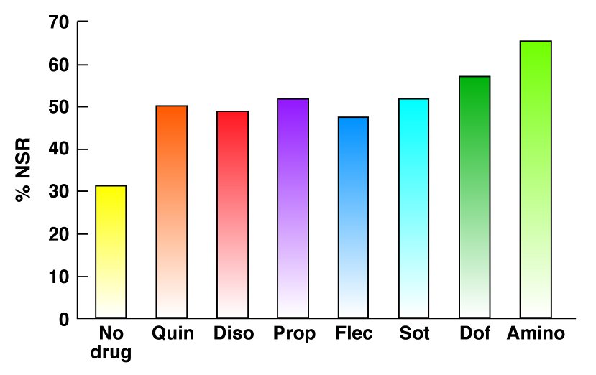
Antiarrhythmic Drugs: Efficacy Maintaining NSR ≥ 6 Months
Amio

Slide 63
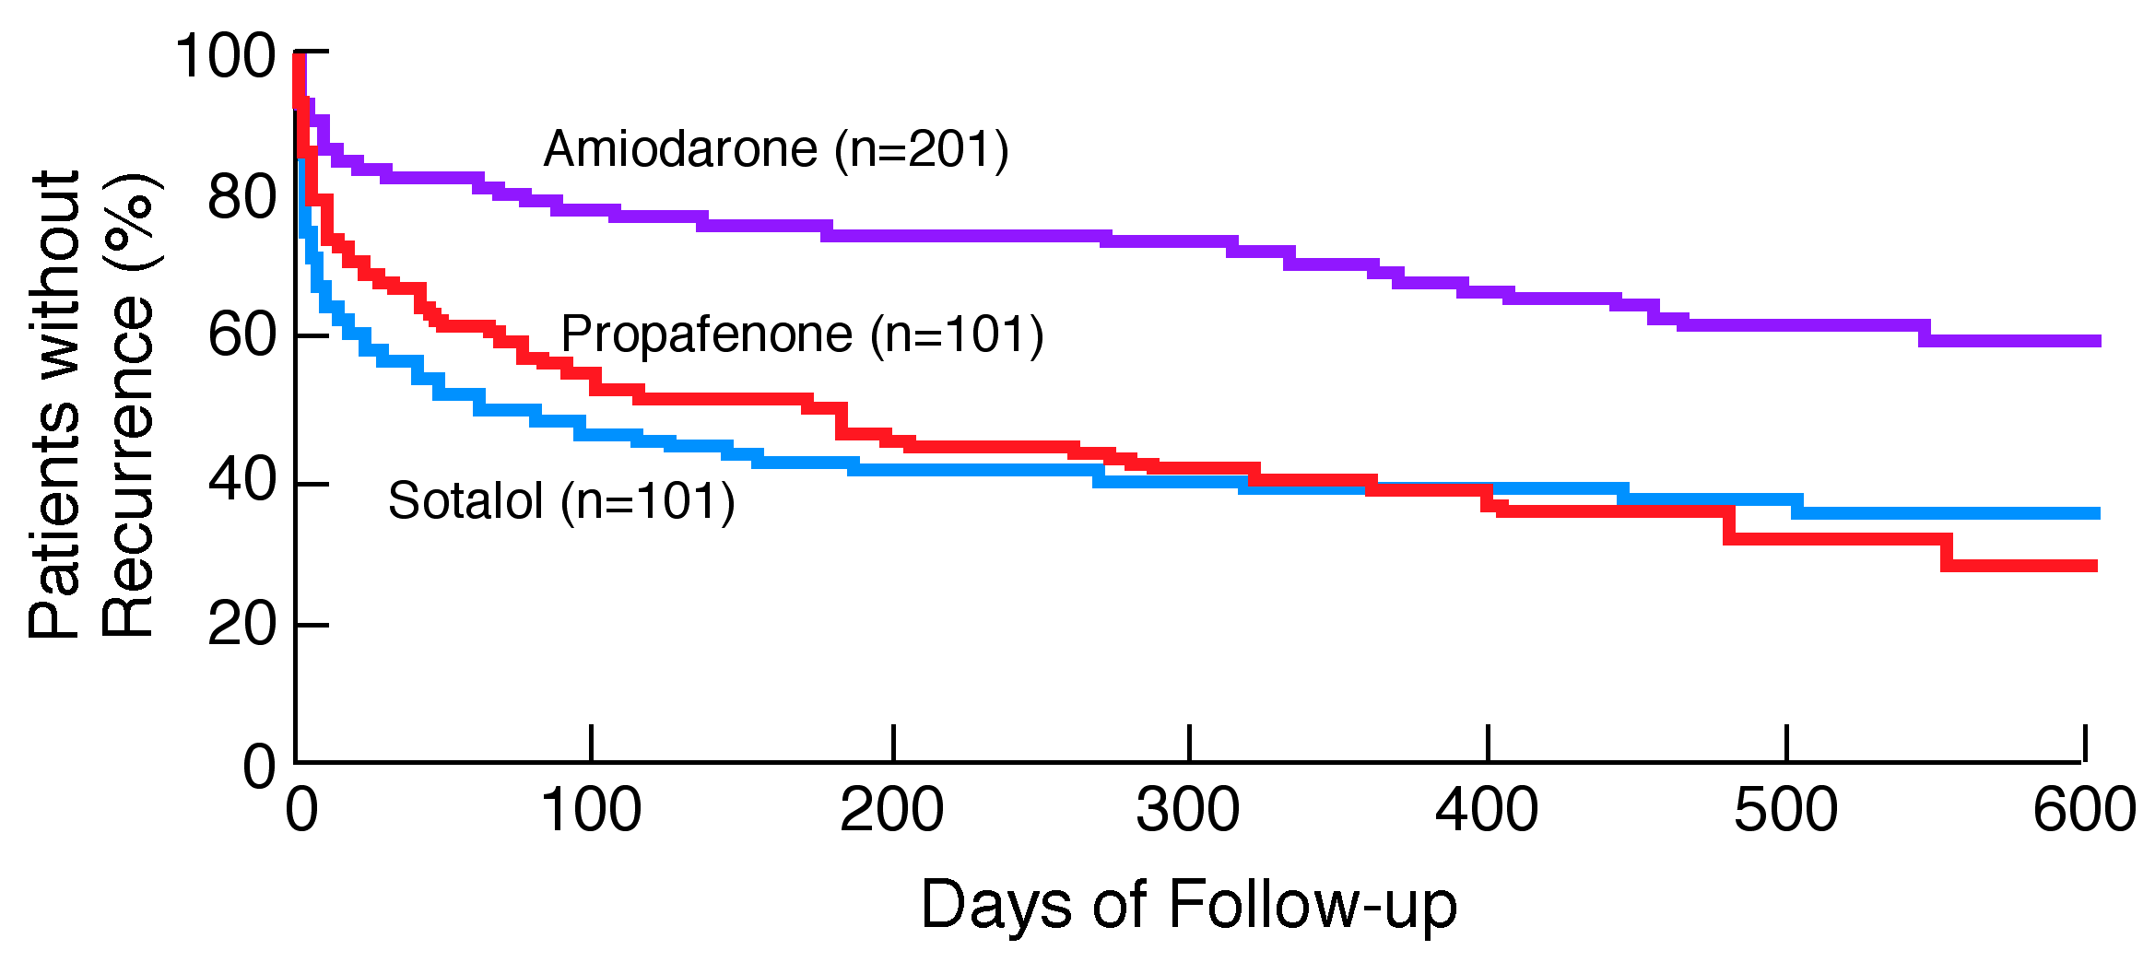
CTAF Trial
N Engl J Med. 2000;342:913-920.

Slide 64
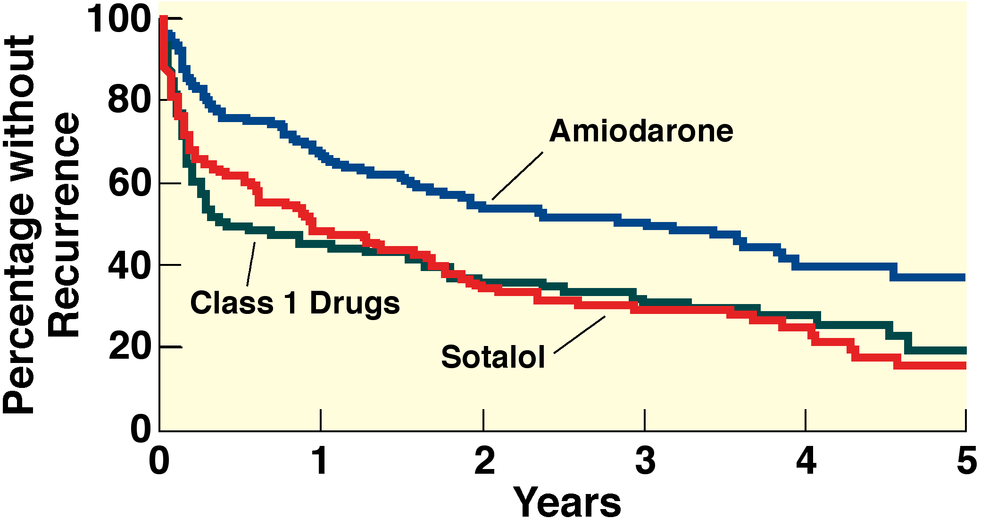
AFFIRM: Antiarrhythmic drug Substudy
(n=106)
(P<0.01)
(n=125)
(n=116)
J Am Coll Cardiol. 2003;42:20-29.

Slide 65
ATHENA Trial (A placebo-controlled, double-blind, parallel arm Trial to assess the efficacy of dronedarone 400 mg bid for the prevention of cardiovascular Hospitalization or death from any cause in patiENts with Atrial fibrillation/atrial flutter)
ATHENA Trial
Presented at Heart Rhythm 2008 in San Francisco, USA
Presented by Stefan H. Hohnloser, MD
Copyleft Clinical Trial Results. You Must Redistribute Slides

Slide 66
ATHENA Trial: Dronedarone
Dronedarone (Multaq®) manufactured by Sanofi-aventis is a new multi-channel blocker that affects the calcium, potassium and sodium channels and has anti-adrenergic properties.
Unlike amiodarone, this drug does not contain iodine radical and hence does not result in adverse effects on thyroid and lung functions.
JCE 2008; 19.1/Heart Rhythm 2008

Slide 67
ATHENA Trial: Study Design
4,628 patients >75 years with atrial fibrillation or 70-75 years with atrial fibrillation and at least one additional cardiovascular risk factor prior to randomization.
Double blind. Randomized. Placebo controlled. International multicenter. Mean follow-up 21 months.
R
Multaq® (dronedarone)
400 mg BID
Placebo
12-30 mos. follow-up
Primary Endpoint: composite of all-cause mortality combined with cardiovascular hospitalization
Secondary Endpoint: death from any cause, cardiovascular death, hospitalization for cardiovascular reasons
Copyleft Clinical Trial Results. You Must Redistribute Slides
JCE 2008; 19.1/Heart Rhythm 2008

Slide 68
ATHENA Trial: Inclusion Criteria
≥75 yrs with or without additional risk factors
≥70 yrs with at least one of the following risk factors: arterial hypertension (ongoing therapy with at least two antihypertensive drugs of different classes), diabetes mellitus, prior stroke or transient ischemic attack or systemic embolism, left atrium diameter ≥ 50 mm by M-mode echocardiography, LVEF < 0.40 by 2D-echocardiography.
Copyleft Clinical Trial Results. You Must Redistribute Slides
JCE 2008; 19.1/Heart Rhythm 2008

Slide 69
ATHENA Trial: Exclusion Criteria
Presence of one of the following cardiac conditions:
Permanent AF
Unstable hemodynamic situation (i.e., recently decompensated heart failure)
Congestive heart failure NYHA class IV
Planned major non-cardiac or cardiac surgery
Acute myocarditis
Bradycardia < 50 bpm and/or a PR interval > 0.28 seconds
Significant sinus node disease in the past, if not treated with a pacemaker
Copyleft Clinical Trial Results. You Must Redistribute Slides
JCE 2008; 19.1/Heart Rhythm 2008

Slide 70
ATHENA Trial: Primary Endpoint Results
Multaq® (dronedarone) decreased the risk of cardiovascular hospitalizations or death from any cause by 24% (p<0.001).
Copyleft Clinical Trial Results. You Must Redistribute Slides
JCE 2008; 19.1/Heart Rhythm 2008

Slide 71
ATHENA Trial: Secondary Endpoint Results
Compared to placebo, Multaq® (dronedarone) significantly decreased the risk of cardiovascular death by 30% (p=0.034).
Multaq® (dronedarone) was associated with numerically fewer deaths from any cause (16%, p=0.17).
First cardiovascular hospitalization was reduced by 25% (p=<0.001).
Copyleft Clinical Trial Results. You Must Redistribute Slides
JCE 2008; 19.1/Heart Rhythm 2008

Slide 72
ATHENA Trial: Other Outcomes
Death from arrhythmias was reduced by 45% (p=0.01) when patients were treated with Multaq® (dronedarone).
Multaq® (dronedarone) demonstrated a lower risk of pro-arrhythmia than placebo and no excess of hospitalizations for congestive heart failure.
The rate of study drug discontinuation was similar between the two study arms.
Copyleft Clinical Trial Results. You Must Redistribute Slides
JCE 2008; 19.1/Heart Rhythm 2008

Slide 73
ATHENA Trial: Summary
Multaq® (dronedarone) has been discovered as the first safe drug to benefit patients with atrial fibrillation.
Findings include decreased rates of cardiovascular hospitalization and mortality.
JCE 2008; 19.1/Heart Rhythm 2008

Slide 74
Adverse Effects of Amiodarone
Excess bradycardia/heart block
Corneal microdeposits
Phtosensitivity/ skin pigmentation
Hyper/hypothroidism
Pulmonary fibrosis/interstitial pneumonitis
Hepatotoxicity
Peripheral neuropathy

Slide 75
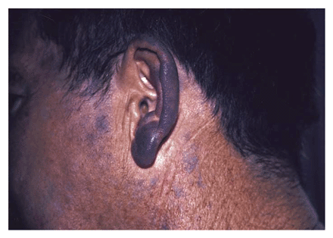
Pigmentation due to Amiodarone
Notes:
A 55-year-old man had blue-gray discoloration of the auricular and periauricular areas of his ears. In 1985, he had had a large anterior myocardial infarction during aortic-valve replacement. Three years later, he had begun to take 400 mg of amiodarone per day for persistent ventricular tachycardia. While taking amiodarone, he began to have photosensitivity, followed by progressive blue-gray pigmentation of areas of his head and face that were exposed to the sun. This pigment has been shown to consist of electron-dense, compact, lamellar granules in the lysosomes of dermal macrophages, similar to lipofuscin. The use of protective clothing and opaque sunscreens was helpful and limited further hyperpigmentation. In 1997, a transvenous cardioverter–defibrillator was implanted, and the dose of amiodarone was decreased to 200 mg per day, five days per week. Twenty months later, the pigmentation had decreased. Complete resolution cannot be expected unless amiodarone is discontinued, in which case the pigment typically clears over a period of months or years.

Slide 76
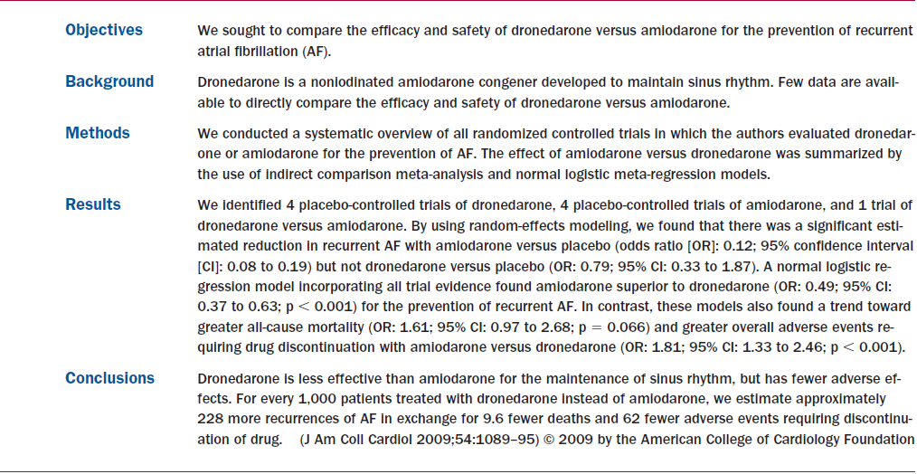

Slide 77
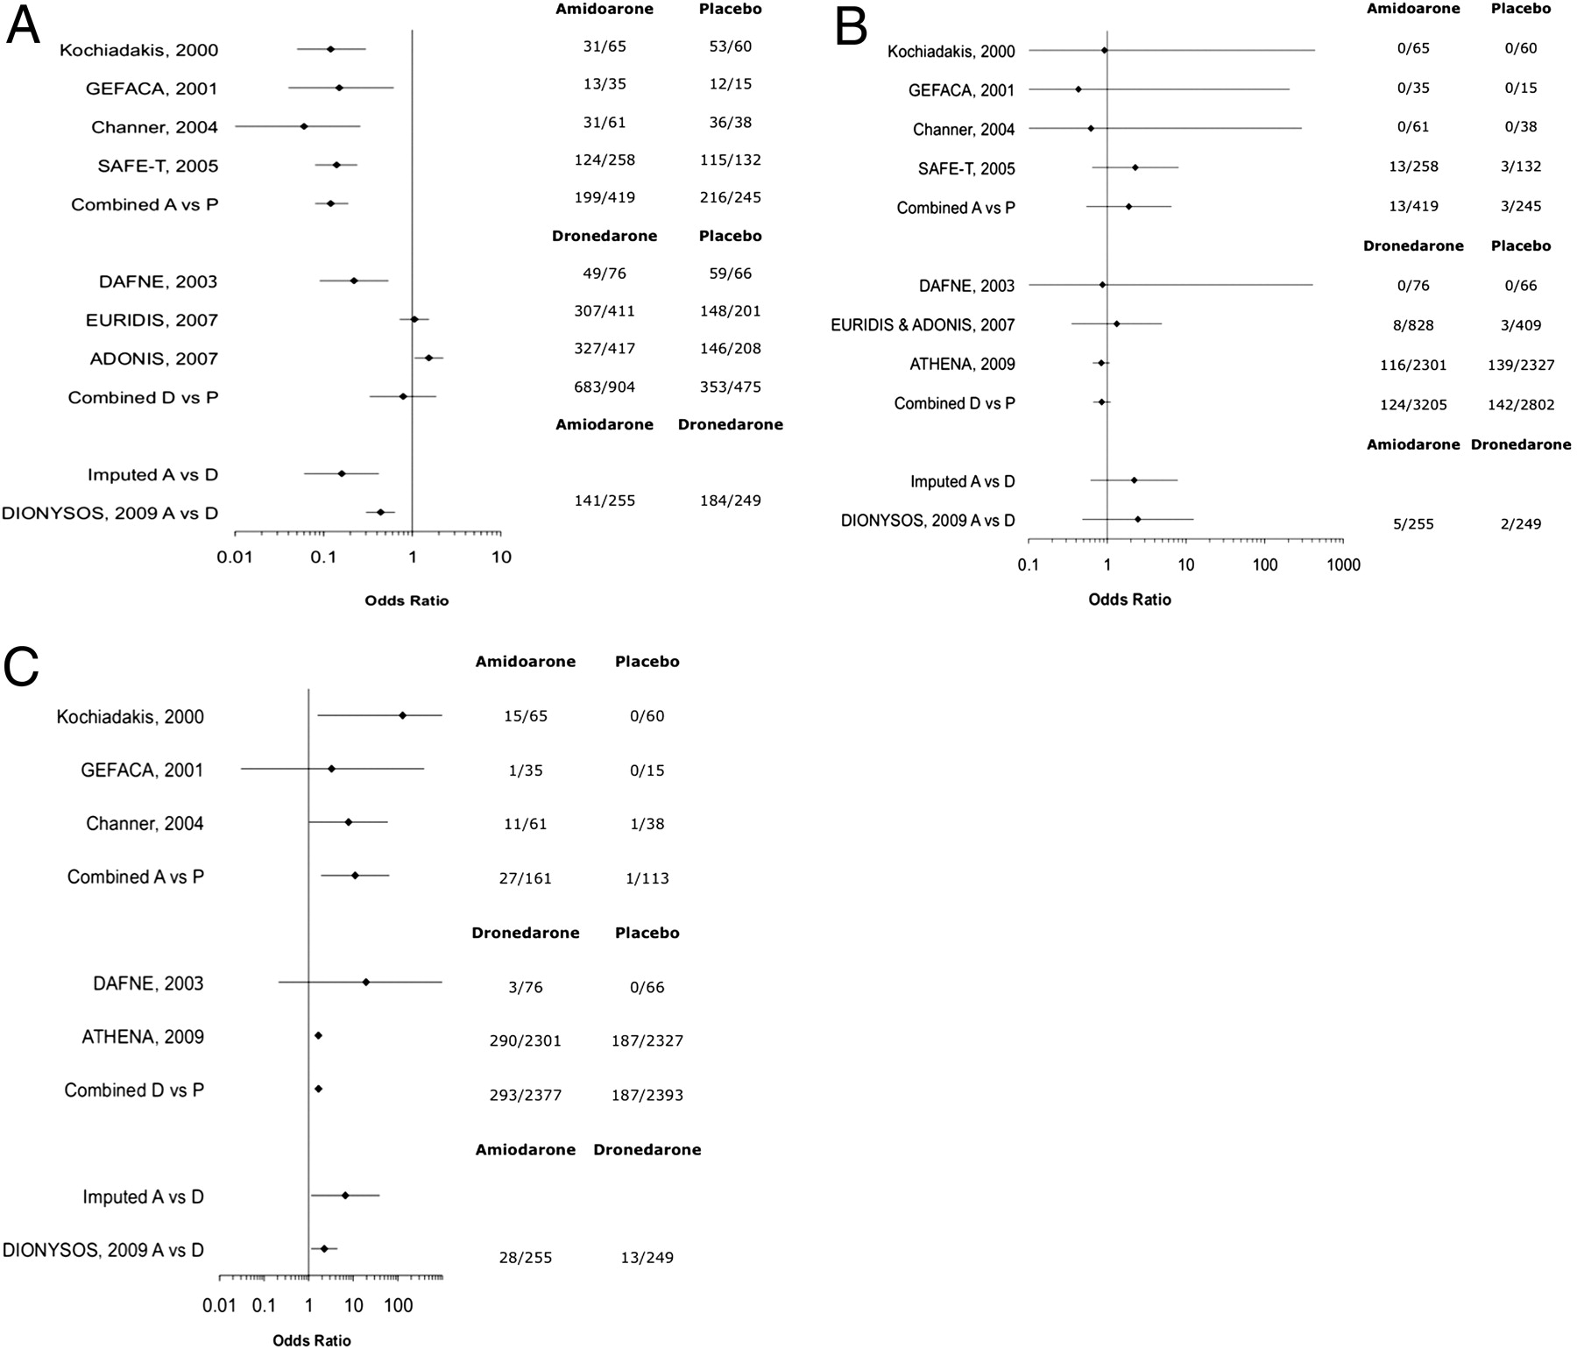
Treatment Effect Estimates for Amiodarone and Dronedarone
Piccini, J. P. et al. J Am Coll Cardiol 2009;54:1089-1095
Copyright ©2009 American College of Cardiology Foundation. Restrictions may apply.

Slide 78
Electrophysiologic Interventions for Atrial Fibrillation
Consider AV nodal ablation and VVIR permanent pacer implantation in patients with inadequate pharmacologic rate control, persisting symptoms or anti-arrhythmic intolerance [CCS Level I-A]
Atrial mapping and atrial fibrillation ablation in highly selected cases

Slide 79
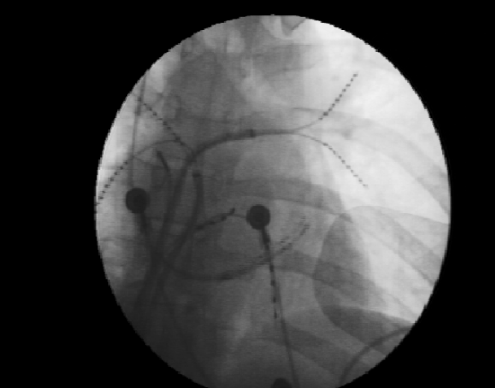

Slide 80
Catheter Ablation Therapy for AFib
Results better with paroxysmal > permanent Afib
Patients who have failed one or two anti-arrhythmic drugs
LA size < 55 mm
Minimal underlying structural HD
TEE to exclude LA thrombus
Spiral CT for PV anatomy

Slide 81
Catheter Ablation Therapy for AFib Rhythm Control
Patients with AFib and pre-excitation especially with syncope, rapid VR or short accessory pathway refractory period [CCS Level I-B]
Young patients with lone paroxysmal AFib [CCS Level IIa-B]
Patients with symptomatic recurrent paroxysmal Afib [CCS Level IIa-B]

Slide 82
Catheter Ablation Therapy for Atrial Fib Rate Control
Patients with highly symptomatic permanent AFib with rapid VR, inadequate pharmacologic rate control or anti-arrhythmic intolerance [CCS Level I-B]
Patients with highly symptomatic paroxysmal AFib in whom rhythm control ineffective and pharmacologic rate control ineffective or not tolerated [CCS Level I-B]

Slide 83
Atrial Fib Following Cardiac Surgery
Afib common following heart surgery
30% CABG patients
40% Valve surgery
50% combined CABG + valve surgery

Slide 84
Atrial Fib Following Cardiac Surgery
Continue β-blocker through peri-operative period [CCS Level I-A]
Treat post-op Afib with β-blocker, non-dihydropyridine CCB or amiodarone for ventricular rate control [CCS Level I-B]
Consider prophylactic peri-operative β-blocker or amiodarone to prevent post-op Afib [CCS Level IIa-B]
Treat post-op Afib with rate control or rhythm control strategy [CCS Level IIa-A]
Consider anticoagulation if Afib persists > 48 hours [CCS Level IIa-C]
Reassess ongoing need for anticoagulation, rate or rhythm control at 6-8 wks.

Slide 85
Atrial Fib and Special Circumstances: Hypertrophic Cardiomyopathy
Afib occurrence ~ 25%. Increased risk of sudden & non-sudden death, CHF & CVA
Anticoagulation indicated [CCS Level I-B]
Rhythm control preferred over rate control [CCS Level IIa-C]
Amiodarone is preferred anti-arrhythmic agent [CCS Level IIa-C]

Slide 86
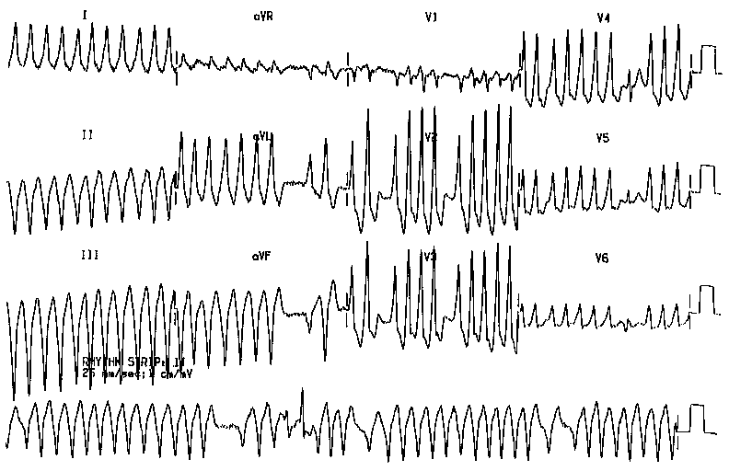
A 47 year old man with a long history of palpitations and blackouts
Notes:
Wolf-Parkinson-White syndrome with atrial fibrillation
irregularly irregular, wide complex tachycardia
impulses from the atria are conducted to the ventricles via either
both the AV node and accessory pathway producing a broad fusion complex
or just the AV node producing a narrow complex (without a delta wave)
or just the accessory pathway producing a very broad 'pure' delta wave
people who develop this rhythm and have very short R - R intervals are at higher risk of VF

Slide 87
Atrial Fib and Special Circumstances: WPW Syndrome
Immediate electrical cardioversion for Afib with hemodynamic compromise [I-B]
IV procainamide or ibutilide for H/D stable pre-excited AFib [ I-C]
Digoxin verapamil, diltiazem or β-blocker contraindicated in AFib with pre-excitation. [CCS Level III-B]. Verapamil, diltiazem or β-blocker may be used for rate control in absence of pre-excited complexes [CCS Level I-C]

Slide 88
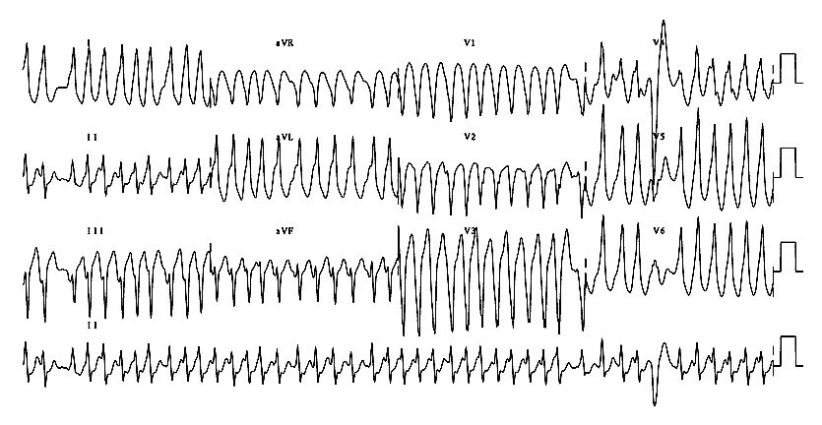
A 23 year old male with palpitations
Notes:
Wolf-Parkinson-White syndrome with atrial fibrillation
irregularly irregular, wide complex tachycardia
impulses from the atria are conducted to the ventricles via either
both the AV node and accessory pathway producing a broad fusion complex
or just the AV node producing a narrow complex (without a delta wave)
or just the accessory pathway producing a very broad 'pure' delta wave
people who develop this rhythm and have very short R - R intervals are at higher risk of VF

Slide 89
Atrial Fib and Special Circumstances: WPW Syndrome
Catheter ablation of accessory pathway recommended in symptomatic patients [CCS Level I-B]
Operative ablation recommended if catheter ablation not feasible or unsuccessful [CCS Level I-B]
Anti-arrhythmic therapy: amiodarone, sotalol, disopyramide, flecainide, propafenone, quinidine or procainamide when ablation not feasible [ I-C]

Slide 90
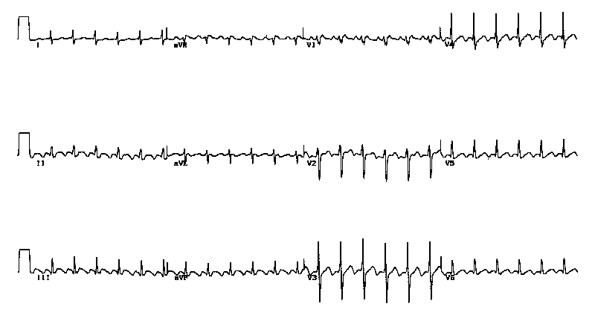
A 57 year old woman with palpitations
Notes:
Atrial flutter with 2:1 AV conduction
The sawtooth waveform of atrial flutter can usually be seen in the inferior leads II, III and aVF if one looks closely. Sometimes the rapid atrial rate can be seen in V1.
Suspect atrial flutter with 2:1 block when you see a rate of about 150 bpm. The atrial rate is shown to be twice the ventricular rate in the figure below.
See also atrial flutter with slow ventricular response.

Slide 91
Atrial Flutter
Either rate or rhythm control strategy is appropriate [CCS Level I-C]
Pharmacologic agents for rate or rhythm control same as for AFib [I-C]
Use AV nodal blocking agent if Class 1C or 1A anti-arrhythmic used [I-C]
Anti-thrombotic recommendations same as for AFib [CCS Level I-C]

Slide 92
Atrial Flutter
Consider catheter ablation may 1st line therapy for symptomatic AFlutter [CCS Level I-B]
AV nodal ablation with permanent pacing limited to symptomatic AFlutter despite optimal therapy when ablation not feasible [CCS Level I-C]

Slide 93
Atrial Fibrillation - Summary
Commonest arrhythmia
Rate > Rhythm control
Anti-thrombotic therapy is key to prevent thromboembolic complications
Anti-arrhythmic therapy in selected symptomatic cases for NSR maintenance
Electrophysiologic intervention in selected cases for rate modulation or ablation

Slide 94
References – Resources Click on Slide for Hyperlink
CCS 2010 Atrial
Fibrillation Guidelines
ESC 2010 Atrial
Fibrillation Guidelines

