Slide 1
Atherosclerotic Regression: Bridging the CARE GAP in Lipid Management 2009
Joel Niznick MD FRCPC
Ottawa Cardiovascular Centre

Slide 2
Atherosclerosis timeline
Foam
cells
Fatty
streak
Intermediate
lesion
Fibrous
plaque
Complicated
lesion/rupture
Atheroma
Endothelial dysfunction
From first decade
From third decade
From fourth decade
Growth mainly by lipid accumulation
Smooth muscle
and collagen
Thrombosis,
haematoma
Stary HC et al. Cir 1995;92(5):1355-1374.
Notes:
This graphic illustrates the history of plaque formation. Early lesions in the form of isolated macrophage foam cells may occur in infancy. Lipid accumulation can then lead to a fatty streak. Next, lipids accumulate in the extracellular space within the vessel wall. After age 30, an atheroma or visible lipid core may develop. At this point, plaque growth is marked primarily by lipid accumulation. From the age of 40 onwards, plaques become more fibrous, a process which is dependent on the growth of a matrix of smooth muscle cells and collagen over the atheromatous core. Finally, if unstable, plaques may erode or rupture. Once the contents of the plaque are exposed to blood, platelet activation and thrombosis may occur.
Atherosclerosis is a pathological process in which atheromatous plaques develop within the inner walls of arteries. It develops slowly over many years. These plaques cause the thickening and hardening of the arterial wall. Advanced plaques can lead to symptomatic cardiovascular disease. In recent years, the understanding of the mechanisms involved in atherogenesis has increased.
Several hypotheses have been proposed to explain how atherosclerosis develops. Currently, the "response to injury" hypothesis is the most favoured.
Plaque formation is thought to occur as a result of a protective response following damage to the endothelium of the arterial wall, the single layers of cells covering the intima. This damage may be caused by a variety of factors such as elevated levels of cholesterol or glucose, hypertension, atherogenic diet, or toxins from cigarette smoke.
Rupture or erosion of the plaque may occur and is not dependent on the size of the plaque but may depend on the overall vulnerability of the plaque to rupture. Small parts of the plaque – or clumps of adherent platelets – may break off, forming emboli, which circulate in the vascular system. The embolus will become lodged in an artery or a smaller vessel, and may cause a blockage that deprives tissues further downstream of oxygen, and ultimately may lead to a cardiovascular event. Rupture also provides an ideal site for blood clot or thrombus formation which may occlude the artery, as in an MI for example. Hemorrhage into plaques can also occur.
Plaques may become calcified, leading to reduced elasticity of the artery and a weakening of the vessel wall. A thinner and weaker vessel wall can lead to an aneurysm and possible hemorrhage.
Reference:
Stary HC, Chandler AB, Dinsmore RE et al. A definition of advanced types of atherosclerotic lesions and a histological classification of atherosclerosis. A report from the Committee on Vascular Lesions of the Council on Arteriosclerosis, American Heart Association. Circulation 1995;92(5):1355-1374.

Slide 3
Goals of Lipid Lowering Therapy
Prevent initiation of atherosclerosis
Stop progression of atherosclerosis
Induce regression of atherosclerosis
Achieve therapeutic targets
Optimize surrogate endpoints
Prevent 1° events
Prevent 2 ° events

Slide 4
VERY HIGH | CVD, CBVD, PVD, DM | OPTIONAL ATP III LDL < 1.8 mmol/L TC/HDL 3:1 | DUAL TARGETING LDL ↓ 55% HDL ↑ 15%
HIGH | > 20 % | TARGET LDL < 2.0 mmol/L TC/HDL 4:1 | Minimum 50% LDL ↓
MODERATE | 10 – 20 % | Evaluate Risk Tx if LDL ≥ 3.5 (Minimum 40% LDL ↓) TC/HDL 5:1 | FH, Ethnicity, GXT, ABI, IMT, Met Syn, ↑CRP Elevates risk
LOW | < 10 % | Less Aggressive Tx if LDL ≥ 5.0 (Minimum 40% LDL ↓) TC/HDL 6:1 | DIET EXERCISE LIFESTYLE
}70%

Slide 5
N Engl J Med
Volume 356(23):2388-2398
June 7, 2007

Slide 6
Explaining the fall in CHD deaths in USA 1980-2000 : RESULTS
NEJM 2007; 356: 2388.
Risk Factors worse +17%
Obesity (increase) +7%
Diabetes (increase) +10%
Risk Factors better -65%
Population BP fall -20%
Smoking -12%
Cholesterol (diet) -24%
Physical activity -5%
Treatments -47%
AMI treatments -10%
Secondary prevention -11%
Heart failure -9%
Angina:CABG & PTCA -5%
Hypertension therapies -7%
Statins (primary prevention) -5%
Unexplained -9%
342,000
fewer deaths
in 2000 →
1980
2000
Notes:
6

Slide 7
Is Lower Better? Clinical Outcome Trials
4S-Pl
Disadvantages
Large sample size
Long duration of studies
Expensive
Mean therapeutic targets
Difficult to show incremental benefit over contemporary therapy
25
Secondary prevention
Primary prevention
TNT Entry
20
Lipid-Pl
4S-Rx
With CHD
event
(%)
15
CARE-Rx
CARE-Pl
10
Lipid-Rx
WOS-Pl
WOS-Rx
TNT 10 mg
5
AFCAPS-Rx
TNT 80 mg
AFCAPS-Pl
0
50
(1.3)
70
(1.8)
90
(2.3)
110
(2.8)
130
(3.4)
150
(3.9)
170
(4.4)
190
(4.9)
210
(5.4)
LDL-cholesterol [mg/dL (mmol/L)]

Slide 8
Notes:
The evidence for very low LDL was very compellingly summarised in the Cannon meta-analysis,” reported Dr. Davidson, referring to a 2006 study by Cannon et al.¹⁰ In this meta-analysis of 4 large trials (N = 27,548), intensive lipid lowering produced a 16% reduction (P < .00001) in the risk of coronary death or myocardial infarction as well as in coronary death or any cardiovascular event relative to moderate LDL cholesterol reductions (Figure 2). In the largest of these studies, TNT (Treating to New Targets), which randomised 10,001 patients, a median LDL cholesterol of 2.0 mmol/L was associated with a 22% (P < .001) reduction in the risk of a first major cardiovascular event over a median 4 years of follow-up relative to a median LDL cholesterol of 2.6 mmol/L.¹¹
A series of studies designed to evaluate the effects of moderate to intensive lipid-lowering therapy with intravascular ultrasound (IVUS) appear to explain this benefit by demonstrating a correlation between reductions in LDL cholesterol and improvements in atherosclerosis. Much of this work has been led by Steven E. Nissen, MD, Chairman, Department of Cardiovascular Medicine, The Cleveland Clinic, Cleveland, Ohio. Reviewing this data at DALM 2007, Dr. Nissen said results of REVERSAL (Reversal of Atherosclerosis With Aggressive Lipid Lowering) confirmed that progression of atherosclerosis could be halted when average LDL cholesterol was reduced to 2.0 mmol/L.¹² In a subsequent study, called ASTEROID (A Study to Evaluate the Effect of Rosuvastatin on Intravascular Ultrasound–Derived Coronary Atheroma Burden) an average LDL cholesterol level of 1.58 mmol/L was associated with measurable regression of atherosclerosis.¹³
According to Dr. Nissen, “When you look at all of the studies using IVUS, a strong correlation is observed between LDL [cholesterol lowering] and median change in atheroma volume, ranging from regression with ASTEROID to no progression in the intensive treatment arm of REVERSAL to progression with less intensive treatment.”

Slide 9
Surrogate End-point Trials
IVUS Studies
CIMT Studies
Advantages
Smaller sample size
More rapid results
Lower costs
Disadvantages
May not always predict clinical events
Measure parameters earlier in the atherosclerotic timeline

Slide 10
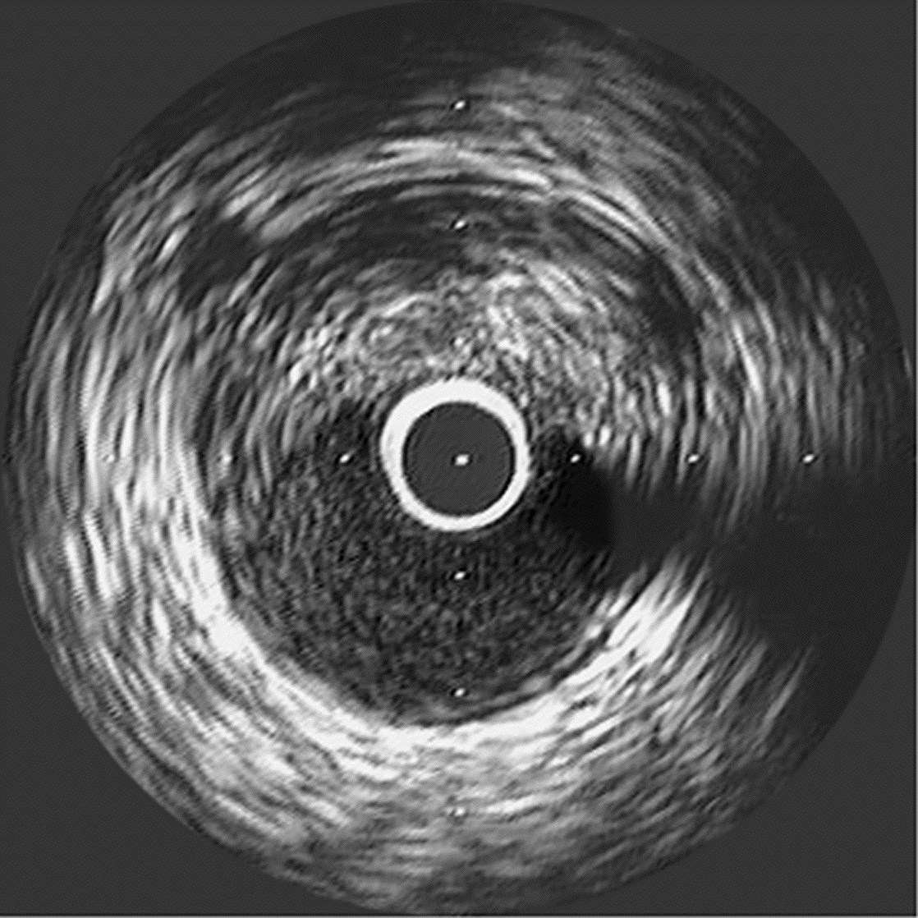
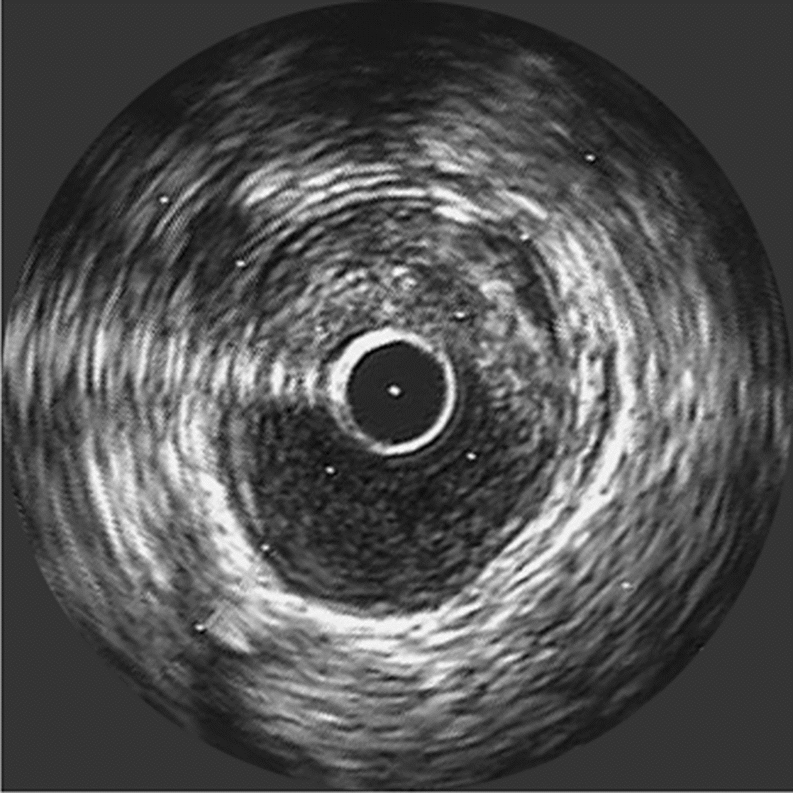
Atheroma Area
10.16 mm²
Baseline
IVUS
Exam
Lumen Area
6.16 mm²
Atheroma Area
5.81 mm²
Follow-up
IVUS
24 months
rosuvastatin
Lumen Area
5.96 mm²

Slide 11
Δ LDL
+ HDL
49.2%
Δ LDL
+ HDL
67.9%
TC/HDL 3.5/1
TC/HDL 2.7/1
Halted
Atherosclerotic
Progression
Induced
Atherosclerotic
Regression

Slide 12
Comparison of LDL-C reduction and change in atheroma volume
20
Both Treatment Groups (n=502)
15
10
5
Change in Atheroma Volume, mm³
0
-5
-10
-15
-80
-70
-60
-50
-40
-30
-20
-10
0
10
20
% Change in Low-Density Lipoprotein Cholesterol
Regardless of the agent used, an LDL-C reduction of at least 50% was required to halt progression.
The dashed lines indicate upper and lower 95% CIs for the mean values
Notes:
Linear regression analysis for both treatment groups showed an inverse relationship between percentage reduction in LDL-C level and progression of atherosclerotic disease.
These data illustrate the benefits of intensive lipid lowering and show that, regardless of the agent used, an LDL-C reduction of at least 50% was required to halt progression.

Slide 13
Recent Coronary IVUS Progression Trials
Relationship between LDL-C and Progression Rate
1.8
CAMELOT
placebo
REVERSAL
pravastatin
1.2
Median
Change
In Percent
Atheroma Volume
(%)
ACTIVATE
placebo
0.6
REVERSAL
atorvastatin
A-Plus
placebo
0
-0.6
r²= 0.95
p<0.001
ASTEROID
rosuvastatin
-1.2
50
60
70
80
90
100
110
120
Mean Low-Density Lipoprotein Cholesterol (mg/dL)

Slide 14
CIMT as a surrogate endpoint:
requires the treatment population to have an abnormal baseline CIMT !!!
ASAP = 0.92 ; SANDS = 0.81 mm; ENHANCE = 0.70 mm
:
ASAP: 1997-8
Treatment naive
0.95
P < .001
ASAP
Progression
Simva LDL-C 40%
0.90
Atorva LDL-C 52%
0.85
0.80
CIMT mm
ENHANCE: 2002-6
Nontreatment naive
0.75
P = .17
ENHANCE
0.70
Simva LDL-C 40%
0.65
Simva/Eze LDL-C 57%
Regression
0
1
2
years
Notes:
14
14

Slide 15
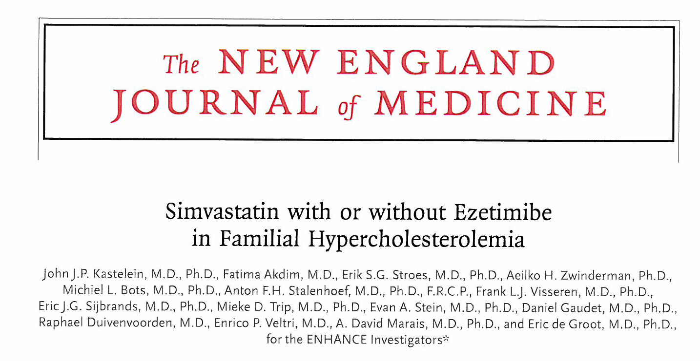

Slide 16
Mean cIMT during 24 months of therapy
0.80
Longitudinal, repeated measures analysis
0.75
P=0.88
0.70
Mean IMT (mm)
0.65
0.60
6
12
18
24
Months
Simva
ENHANCE
Eze-Simva

Slide 17
Baseline cIMT in LIPID (pediatric), ASAP and ENHANCE
ASAP
ENHANCE
LIPID (pediatric)
 | Baseline mean cIMT (mm)
LIPID (pediatric) | 0.495±0.050
ASAP | 0.92±0.20
ENHANCE | 0.70±0.13
Frequency
0.4
0.8
1.2
1.6
2.0
2.4
ENHANCE
Mean CIMT (mm)

Slide 18
Stop Atherosclerosis in Native Diabetics Study

Slide 19
SANDS* Design: Primary Prevention
American-Indian men and women (N = 499 )
T2DM and no CVD
≥ 40 yrs old
SBP > 130 mmHg, LDL-C > 2.5 mmol/L
Baseline CIMT measured
Randomization
Standard Targets (N = 247)
LDL-C ≤ 2.5 mmol/L
non-HDL-C ≤ 3.5 mmol/L
SBP ≤ 130 mm Hg
Aggressive Targets (N = 252)
LDL-C ≤ 1.8 mmol/L
non-HDL-C ≤ 2.5 mmol/L
SBP ≤ 115 mm Hg
Outcome
Measured CVD using carotid
and cardiac ECHO at baseline,
18 months and 36 months
Primary outcome: change in CIMT
*Howard BV, et al. JAMA. 2008;299:1678-1689.

Slide 20
Algorithm for Lipid Management
LDL Goal:
Statin
Ezetimibe, colesevelam
Non-HDL Goal:
Fenofibrate
Omega-3 fatty acids
Niacin

Slide 21
Algorithm for Blood Pressure Control
ACE or ARB
HCTZ
Atenolol or Nifedipine
Add alternative step 3 agent
Doxazocin
Hydralizine or Minoxidil or Reserpine

Slide 24
Target Achievement and Drugs Required
Targets achieved in both treatment groups
Groups kept apart at 0.8 mmol/L for LDL-C and non-HDL-C
Average Number of Drugs Required in Each Treatment Group
 | Lipid-Lowering | Blood Pressure
Standard | 1.2 | 1.6
Aggressive | 1.5 | 2.4

Slide 25
Changes in CIMT
mm
Intention to treat (ITT) analysis (N = 499)
At 36 months, significant IMT regression in aggressive group vs slowed progression in standard group (P < .001)
Sensitivity analysis (N = 129)
Participants maintaining LDL-C ≤ 1.8 mmol/L during last 12 months of intervention showed further IMT regression, compared with standard group (P < .001)

Slide 26
SANDS Population Sub-study
SANDS substudy of aggressive group (N = 213)
32% of patients in aggressive group were taking statin + ezetimibe
68% on statin mono-therapy
Comparison of CIMT and lipid lowering at 36 months in 3 groups:
Aggressive group (E-): statin alone (N = 144)
Aggressive group (E+): statin + ezetimibe (N = 69 )
Standard group (S): statin WITHOUT ezetimibe (N = 204)

Slide 27
Change in Lipid and CRP at 36 Months: Standard vs Aggressive Therapy Subgroups
^{ab}
^{ab}
^{ab}
Change in Parameter (mg/dl)
P = .0001
P = .987
P = .0001
P = .11
P = .008
Values are mean (95% confidence interval). The P values were determined using the ANOVA F Test.
ªSignificant difference between S an E+.
^{b}Significant difference between S and E- (based on logarithm of CRP)
Fleg JL, et al. J Am Coll Cardiol. 2008;52:1-8.

Slide 28
Change in CIMT at 36 Months: Standard vs Aggressive Therapy Subgroups
CIMT (mm)
^{a, b}
^{a ,b}
ªP < .001 vs standard group; ^{b} No statistical difference between E+ and E- subgroups
Fleg JL, et al. J Am Coll Cardiol. 2008;52:1-8.

Slide 29
SANDS and Surrogate Endpoints
LDL-C/non-HDL-C were significantly lower at 36 months in both aggressive subgroups as compared with the standard subgroup
The combination of ezetimibe plus statin has essentially an identical beneficial effect on CIMT as statin alone, for a similar change in LDL-C and non-HDL-C.

Slide 30
SANDS and Surrogate Endpoints
Degree of lipid lowering appears to be more important than treatment type (ie, statin alone vs statin + ezetimibe)
~ 1/3 of patients will require combination therapy (statin + ezetimibe) to achieve more aggressive targets

Slide 31
Surrogate Outcome Trials Is Lower Better?
LDL Level mmol/L | Trial (Type) | Treatment | Outcome
1.6 | ASTEROID (IVUS) | Rosuva 40 mg | Regression
1.8 | SANDS [aggressive] (CIMT) | Statin or Statin/ezetimibe | Regression
2.0 | METEOR (CIMT) | Rosuva 40 mg | Halts progression
2.05 | REVERSAL (IVUS) | Atorva 80 mg | Halts progression
2.36 | C ASHMERE (CIMT) | Atorva 80 mg | No diff. vs placebo
2.5 | REVERSAL (IVUS) | Prava 40 mg | Progression
2.5 | SANDS [standard] (CIMT) | Statin alone | Progression
3.5 | ENHANCE (CIMT) | Simva + Ezetimibe | No diff vs statin

Slide 32
So Does it Matter How To Get LDL to Target?
Up-titrate to maximum statin dose yields 6% reduction per statin doubling:
Atorvastatin 10→20 →40 →80 = 18% ↓
Rosuvastatin 5→10→20 →40 = 18% ↓
Adding ezetimibe 10 mg yields incremental 20% LDL reduction
2.5 mmol/L → 2.0 mmol/L
2.0 mmol/L → 1.6 mmol/L

Slide 33
Explorer efficacy Change (%) in lipids and lipoproteins at 6 weeks
Change from baseline (%) | Rosuvastatin 40 mg | Rosuva 40 mg + Ezetimibe 10 mg
LDL–C | -57.1 | -69.8***
HDL–C | 8.5 | 10.8
LDL–C/HDL–C | -59.6 | -72.2***
ApoB/Apo–AI | -45.6 | -56.7***
***P<0.001 versus rosuvastatin. LDL–C = low density lipoprotein cholesterol, HDL–C = high density lipoprotein cholesterol, Apo = apolipoprotein
Ballantyne CM et al. World Congress of Cardiology 2006; September 6, 2006; Barcelona, Spain. Poster 5390.

Slide 34
EXPLORER: Patients achieving NCEP ATP III treatment goals and low CRP levels
All P values < 0.001
% Control rates
+ CRP <2 + CRP <2
Ballantyne CM et al. World Congress of Cardiology 2006; September 6, 2006; Barcelona, Spain. Poster 5390.

Slide 35
LDL Control Rates: The bar is 80% target achievement to whatever target selected

Slide 36
CWG LDL Target Revision
Old LDL Target 2.5 mmol/L
New LDL Target 2.0 mmol/L
}
EZETROL 20% LDL Reduction
20% ↓

Slide 38
Is Lower Safe?

Slide 39
1^{O} endpoint: death, MI, stroke, recurrent ischaemia, revascularization

Slide 40
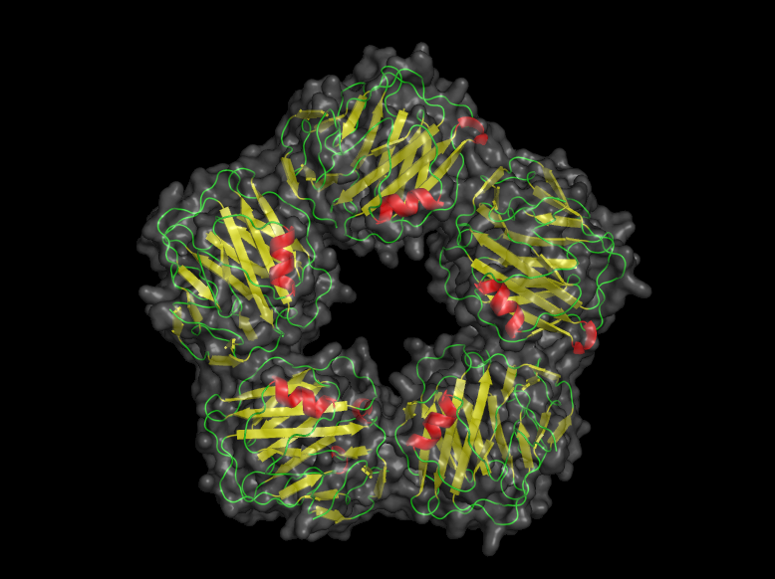
What About CRP?

Slide 41
JUPITER
AHA November 9, 2008
A Randomized Trial of Rosuvastatin in the Prevention
of Cardiovascular Events Among 17,802 Apparently Healthy
Men and Women With Elevated Levels
of C-Reactive Protein (hsCRP):
The JUPITER Trial
Paul Ridker*, Eleanor Danielson, Francisco Fonseca*, Jacques Genest*,
Antonio Gotto*, John Kastelein*, Wolfgang Koenig*, Peter Libby*,
Alberto Lorenzatti*, Jean MacFadyen, Borge Nordestgaard*,
James Shepherd*, James Willerson, and Robert Glynn*
on behalf of the JUPITER Trial Study Group
An Investigator Initiated Trial Funded by AstraZeneca, USA
* These authors have received research grant support and/or consultation fees from one or more
statin manufacturers, including Astra-Zeneca. Dr Ridker is a co-inventor on patents held by the
Brigham and Women’s Hospital that relate to the use of inflammatory biomarkers in
cardiovascular disease that have been licensed to Dade-Behring and AstraZeneca.

Slide 42
JUPITER
Trial Design
JUPITER Multi-National Randomized Double Blind Placebo Controlled Trial of Rosuvastatin in the Prevention of Cardiovascular Events Among Individuals With Low LDL and Elevated hsCRP
Rosuvastatin 20 mg (N=8901)
MI
Stroke
Unstable
Angina
CVD Death
CABG/PTCA
No Prior CVD or DM
Men >50, Women >60
LDL <130 mg/dL
hsCRP >2 mg/L
4-week run-in
Placebo (N=8901)
Argentina, Belgium, Brazil, Bulgaria, Canada, Chile, Colombia, Costa Rica,
Denmark, El Salvador, Estonia, Germany, Israel, Mexico, Netherlands,
Norway, Panama, Poland, Romania, Russia, South Africa, Switzerland,
United Kingdom, Uruguay, United States, Venezuela
Ridker et al, Circulation 2003;108:2292-2297.

Slide 43
JUPITER
Inclusion and Exclusion Criteria, Study Flow
Ridker et al NEJM 2008
89,890 Screened
89,863 Screened
Reason for Exclusion (%)
LDL > 130 mg/dL 52
hsCRP < 2.0 mg/L 36
Withdrew Consent 5
Diabetes 1
Hypothyroid <1
Liver Disease <1
TG > 500 mg/dL <1
Age out of range <1
Current Use of HRT <1
Cancer <1
Poor Compliance/Other 3
Reason for Exclusion (%)
LDL-C > 130 mg/dL 53
hsCRP < 2.0 mg/L 37
Withdrew Consent 4
Diabetes 1
Hypothyroid <1
Liver Disease <1
TG > 500 mg/dL <1
Age out of range <1
Current Use of HRT <1
Cancer <1
Poor Compliance/Other 3
Men > 50 years
Women > 60 years
No CVD, No DM
LDL < 130 mg/dL
hsCRP > 2 mg/L
4 week
Placebo
Run-In
17,802 Randomized
17,802 Randomized
8,901 Assigned to
Rosuvastatin 20 mg
8,901 Assigned to
Placebo
8,901 Assigned to
Rosuvastatin 20 mg
8,901 Assigned to
Placebo
8,857 Completed Study
44 Lost to follow-up
8,864 Completed Study
37 Lost to follow-up
8,600 Completed Study
120 Lost to follow-up
8,600 Completed Study
120 Lost to follow-up
8,901 Included in Efficacy
and Safety Analyses
8,901 Included in Efficacy
and Safety Analyses
8,901 Included in Efficacy
and Safety Analyses
8,901 Included in Efficacy
and Safety Analyses

Slide 44
JUPITER
Effects of rosuvastatin 20 mg on LDL, HDL, TG, and hsCRP
Ridker et al NEJM 2008
LDL (mg/dL)
HDL (mg/dL)
LDL decrease 50 percent at 12 months
HDL increase 4 percent at 12 months
hsCRP (mg/L)
TG (mg/dL)
hsCRP decrease 37 percent at 12 months
TG decrease 17 percent at 12 months
0
12
24
36
48
Months
Months

Slide 45
JUPITER
Primary Trial Endpoint : MI, Stroke, UA/Revascularization, CV Death
Ridker et al NEJM 2008
HR 0.56, 95% CI 0.46-0.69
P < 0.00001
Placebo 251 / 8901
0.08
0.06
- 44 %
Cumulative Incidence
0.04
Rosuvastatin 142 / 8901
0.02
0.00
0
1
2
3
4
Number at Risk
Follow-up (years)
Rosuvastatin
8,901
8,631
8,412
6,540
3,893
1,958
1,353
983
544
157
Placebo
8,901
8,621
8,353
6,508
3,872
1,963
1,333
955
534
174

Slide 46
JUPITER
Primary Trial Endpoint : MI, Stroke, UA/Revascularization, CV Death
Ridker et al NEJM 2008
HR 0.56, 95% CI 0.46-0.69
P < 0.00001
Placebo 251 / 8901
0.08
Number Needed to Treat (NNT₅) = 25
0.06
- 44 %
Cumulative Incidence
0.04
Rosuvastatin 142 / 8901
0.02
0.00
0
1
2
3
4
Number at Risk
Follow-up (years)
Rosuvastatin
8,901
8,631
8,412
6,540
3,893
1,958
1,353
983
544
157
Placebo
8,901
8,621
8,353
6,508
3,872
1,963
1,333
955
534
174

Slide 47
JUPITER
Grouped Components of the Primary Endpoint
Ridker et al NEJM 2008
Myocardial Infarction, Stroke, or
Cardiovascular Death
Arterial Revascularization or
Hospitalization for Unstable Angina
HR 0.53, CI 0.40-0.69
P < 0.00001
HR 0.53, CI 0.40-0.70
P < 0.00001
0.05
Placebo
0.06
Placebo
0.04
0.05
- 47 %
0.04
0.03
Cumulative Incidence
Cumulative Incidence
- 47 %
0.03
0.02
0.02
0.01
Rosuvastatin
Rosuvastatin
0.01
0.00
0.00
0
1
2
3
4
0
1
2
3
4
Follow-up (years)
Follow-up (years)

Slide 48
JUPITER
Primary Endpoint – Subgroup Analysis I
Ridker et al NEJM 2008
N
P for Interaction
Men
11,001
0.80
Women
6,801
Age
<
65
8,541
0.32
Age > 65
9,261
Smoker
2,820
0.63
Non-Smoker
14,975
Caucasian
12,683
0.57
Non-Caucasian
5,117
USA/Canada
6,041
0.51
Rest of World
11,761
Hypertension
10,208
0.53
No Hypertension
7,586
All Participants
17,802
0.25
0.5
1.0
2.0
4.0
Rosuvastatin Superior
Rosuvastatin Inferior

Slide 49
JUPITER
Primary Endpoint – Subgroup Analysis II
Ridker et al NEJM 2008
N
P for Interaction
Family HX of CHD
2,045
0.07
No Family HX of CHD
15,684
BMI < 25 kg/m
²
4,073
0.70
BMI 25-29.9 kg/m
²
7,009
BMI
>
30 kg/m
²
6,675
Metabolic Syndrome
7,375
0.14
No Metabolic Syndrome
10,296
Framingham Risk
<
10%
8,882
0.99
Framingham Risk > 10%
8,895
hsCRP > 2 mg/L Only
6,375
hsCRP > 2 mg/L Only
6,375
All Participants
17,802
0.25
0.5
1.0
2.0
4.0
Rosuvastatin Superior
Rosuvastatin Inferior

Slide 50
JUPITER
Secondary Endpoint – All Cause Mortality
Ridker et al NEJM 2008
HR 0.80, 95%CI 0.67-0.97
P= 0.02
0.06
Placebo 247 / 8901
- 20 %
0.05
0.04
Cumulative Incidence
0.03
Rosuvastatin 198 / 8901
0.02
0.01
0.00
0
1
2
3
4
Number at Risk
Follow-up (years)
Rosuvastatin
8,901
8,847
8,787
6,999
4,312
2,268
1,602
1,192
683
227
Placebo
8,901
8,852
8,775
6,987
4,319
2,295
1,614
1,196
684
246

Slide 51
JUPITER
Conclusions – Efficacy I
Ridker et al NEJM 2008
Among apparently healthy men and women with elevated
hsCRP but low LDL, rosuvastatin reduced by 47 percent
incident myocardial infarction, stroke, and cardiovascular
death.
Despite evaluating a population with lipid levels widely
considered to be “optimal” in almost all current prevention
algorithms, the relative benefit observed in JUPITER was
greater than in almost all prior statin trials.
In this trial of low LDL/high hsCRP individuals who do not
currently qualify for statin therapy, rosuvastatin significantly
reduced all-cause mortality by 20 percent.

Slide 52
JUPITER
Conclusions – Efficacy II
Ridker et al NEJM 2008
Benefits of rosuvastatin were consistent in all sub-groups
evaluated regardless of age, sex, ethnicity, or other baseline
clinical characteristic, including those with elevated hsCRP
and no other major risk factor.
Rates of hospitalization and revascularization were reduced
by 47 percent within a two-year period suggesting that the
screening and treatment strategy tested in JUPITER is
likely to be cost-effective, benefiting both patients and payers.
The Number Needed to Treat in JUPITER was 25 for the primary
endpoint, a value if anything smaller than that associated
with treating hyperlipidemia in primary prevention.

Slide 53
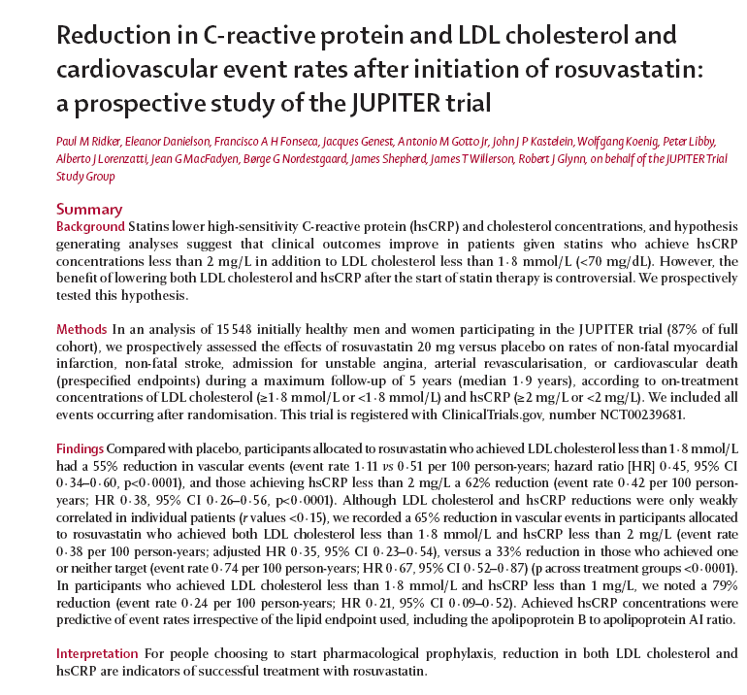

Slide 54
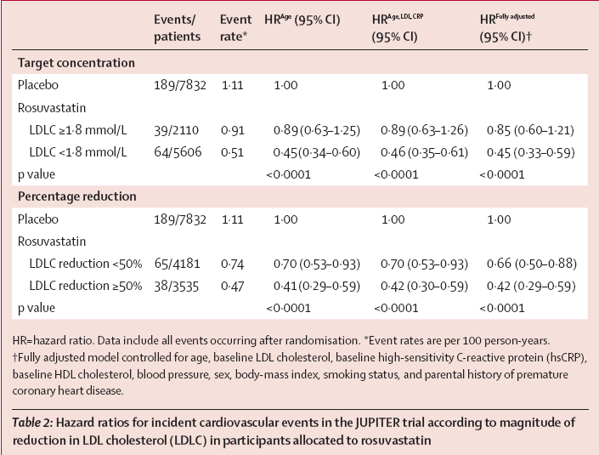

Slide 55
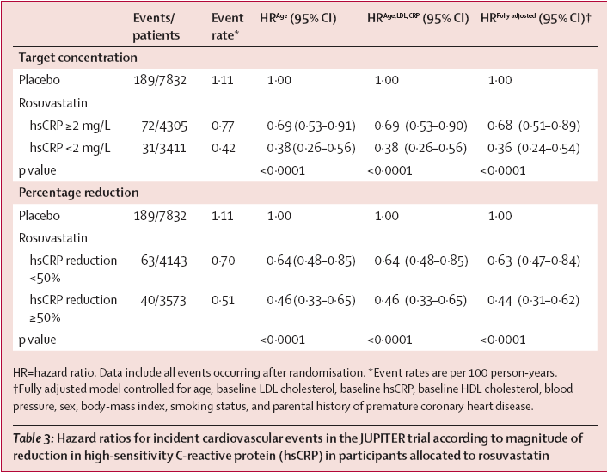

Slide 56
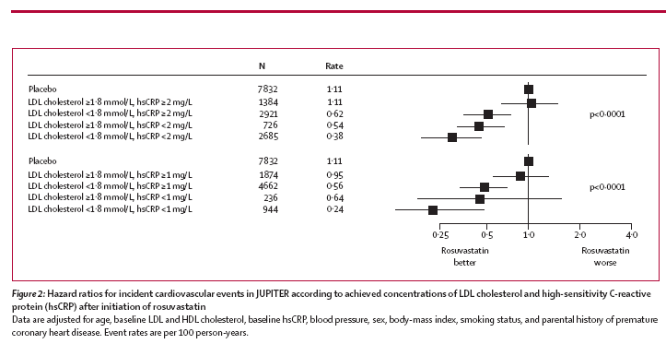

Slide 57
2009 CCS Dyslipidemia and Prevention Guidelines

Slide 61
Framingham 10 Year Risk Total CVD-Men

Slide 62
Framingham 10 Year Risk Total CVD-Women

Slide 64
VERY HIGH | CVD, CBVD, PVD, DM | OPTIONAL ATP III LDL < 1.8 mmol/L TC/HDL 3:1 | DUAL TARGETING LDL ↓ 55% HDL ↑ 15%
HIGH | > 20 % | TARGET LDL < 2.0 mmol/L TC/HDL 4:1 (Minimum 50% LDL ↓) | Minimum 50% LDL ↓
MODERATE | 10 – 20 % | Evaluate Risk Tx if LDL ≥ 3.5 (Minimum 50% LDL ↓) TC/HDL 5:1 | FH, Ethnicity, GXT, ABI, IMT, Met Syn, ↑CRP Elevates risk
LOW | < 10 % | Less Aggressive Tx if LDL ≥ 5.0 (Minimum 50% LDL ↓) TC/HDL 6:1 | DIET EXERCISE LIFESTYLE
}70%

Slide 65
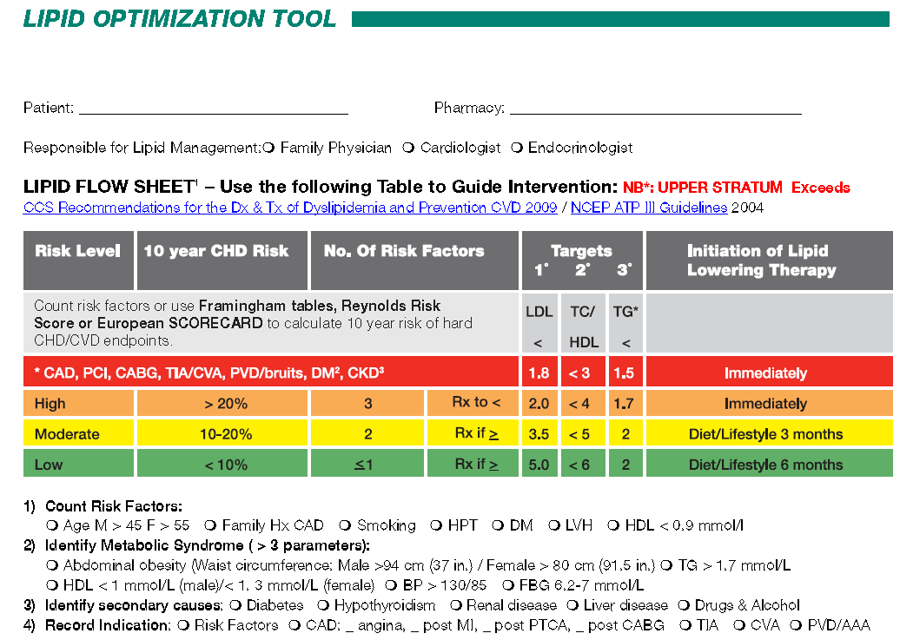

Slide 66
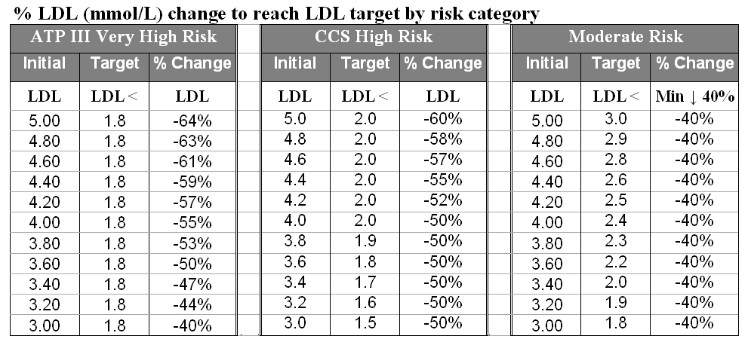
% LDL Reduction to Achieve Target

Slide 68
Lipid Optimization Tool Database

Slide 69
Disclaimer
Guidelines are only guidelines and should always be applied in the context of your best clinical judgment, evolving clinical evidence and experience.
Information, guidelines and medication costs in this database are current as of the copyright date. Costs are based on the Ontario Drug Benefit formulary. Medication costs are subject to change and provincial variation.

Slide 76
Precautions

Slide 87
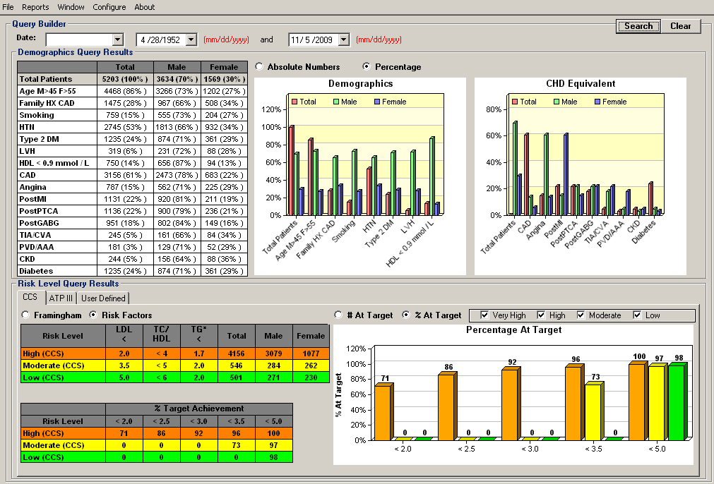

Slide 88
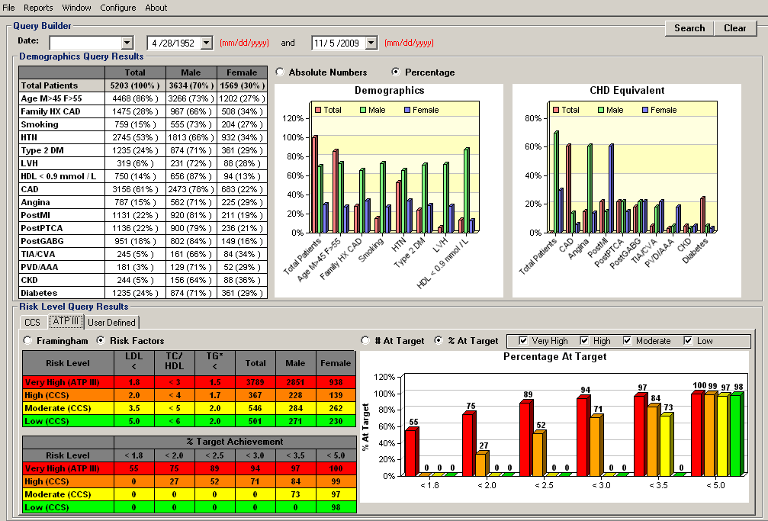

Slide 89
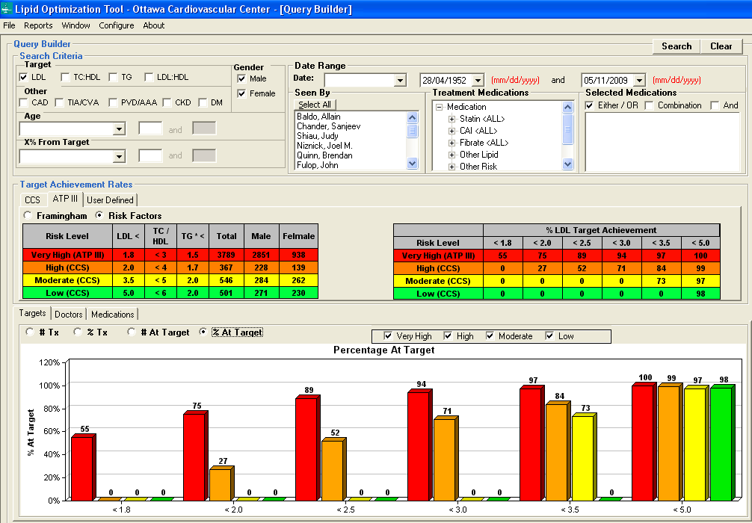

Slide 90
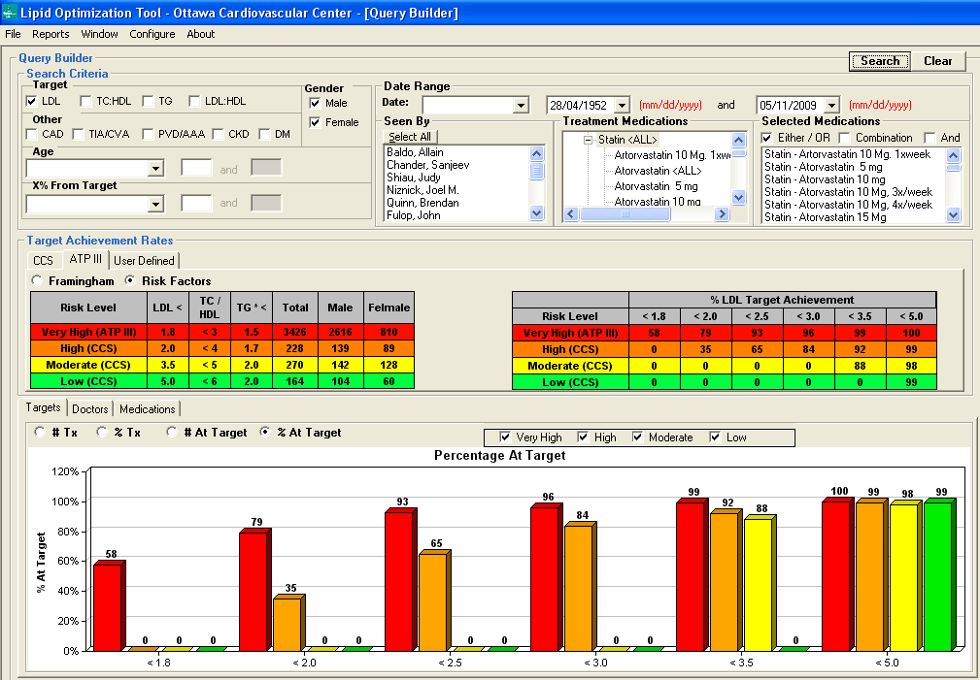

Slide 91
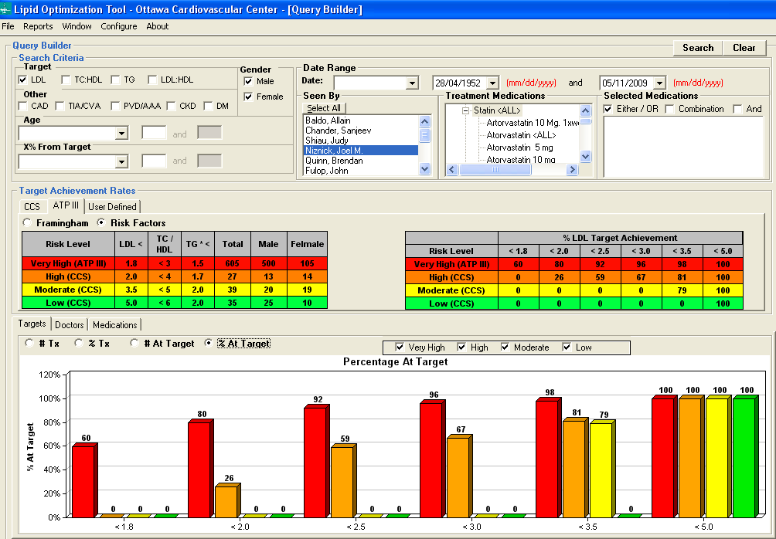

Slide 92
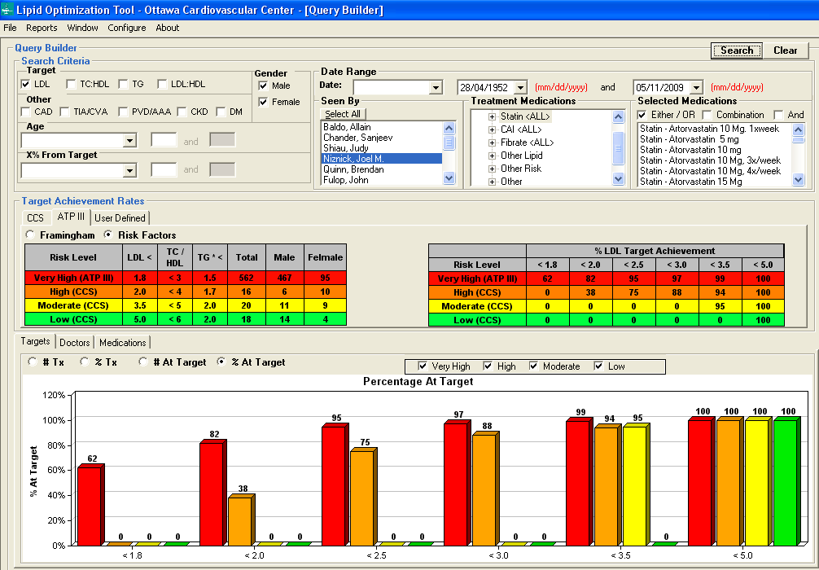

Slide 93
Research Presentations
IAS 6/2006 Rome
EuroPrevent 4/2007 - Madrid

Slide 94
CCC 2007 Poster Presentation

Slide 95
AHA QCOR 2009 Poster Presentation

Slide 96
Percent of patients achieving LDL target 2.5 mmol/L (100 mg/dl)
ST = statin treated SF = Statin Naive
* OCC = Ottawa Cardiovascular Centre

Slide 97
Target LDL Control Rates High and Very High Risk Patients
Target LDL mmol/L | VP/GOALL % at target | CALIPSO % at target | GUIDE % at target | OCC LOT All pts. % at target | OCC LOT Statin pts % at target
< 3.0 |  |  |  | 94 | 96
< 2.5 | 51 | 64 | 71 | 89 | 93
< 2.0 | 22 | 30 | 41 | 75 | 79
< 1.8 | 21 | 19 |  | 55 | 58

