Slide 1
Debunking and Disabusing the Diatribe that Digoxin Delivers Death and Destruction
Digoxin in Clinical Practice
2020

Slide 2
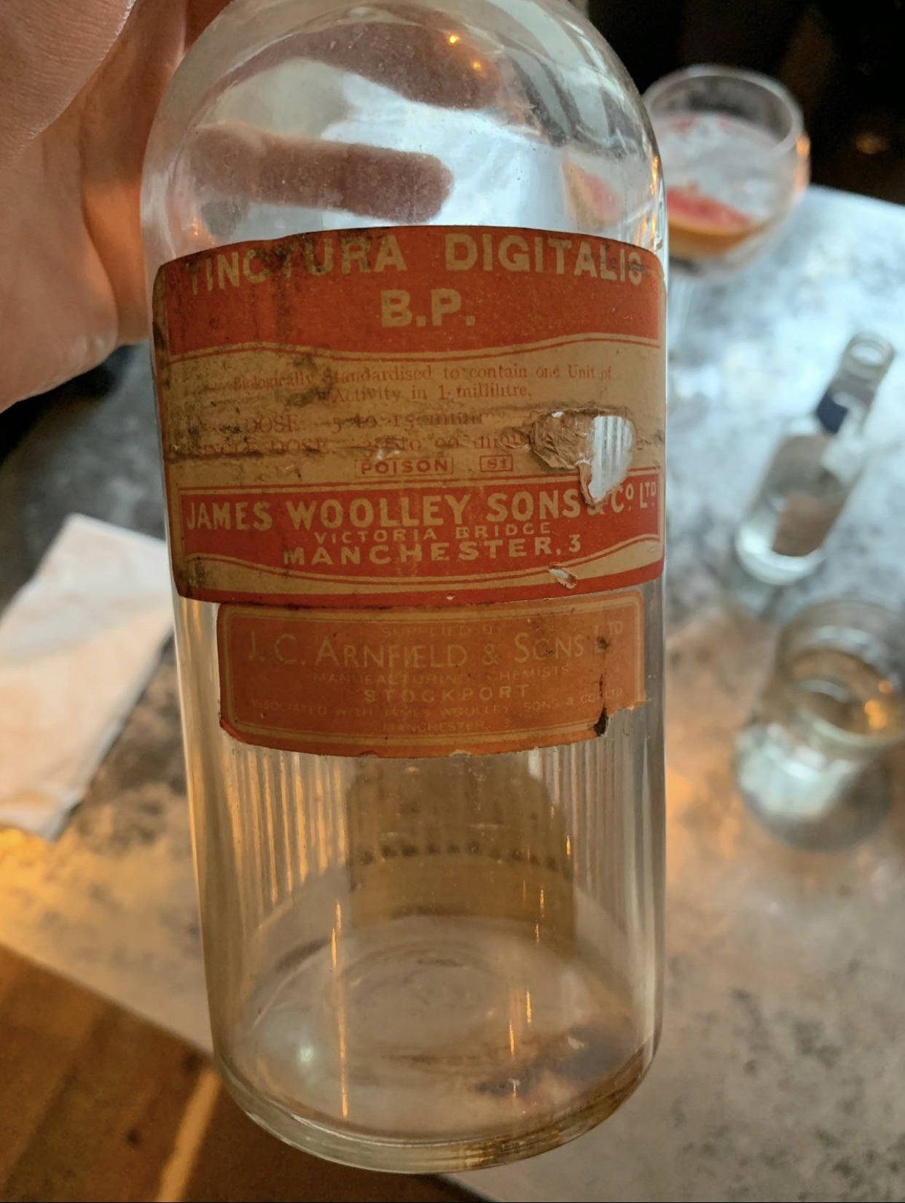

Slide 3
AN ACCOUNT OF THE FOXGLOVE, AND Some of its Medical Uses: WITH PRACTICAL REMARKS ON DROPSY, AND OTHER DISEASES.
BY WILLIAM WITHERING, M. D.
MDCCLXXXV (1785)
“The use of the Foxglove is getting abroad, and it is better the world should derive some instruction, however imperfect, from my experience, than that the lives of men should be hazarded by its unguarded exhibition, or that a medicine of so much efficacy should be condemned and rejected as dangerous and unmanageable.”

Slide 4


Slide 5
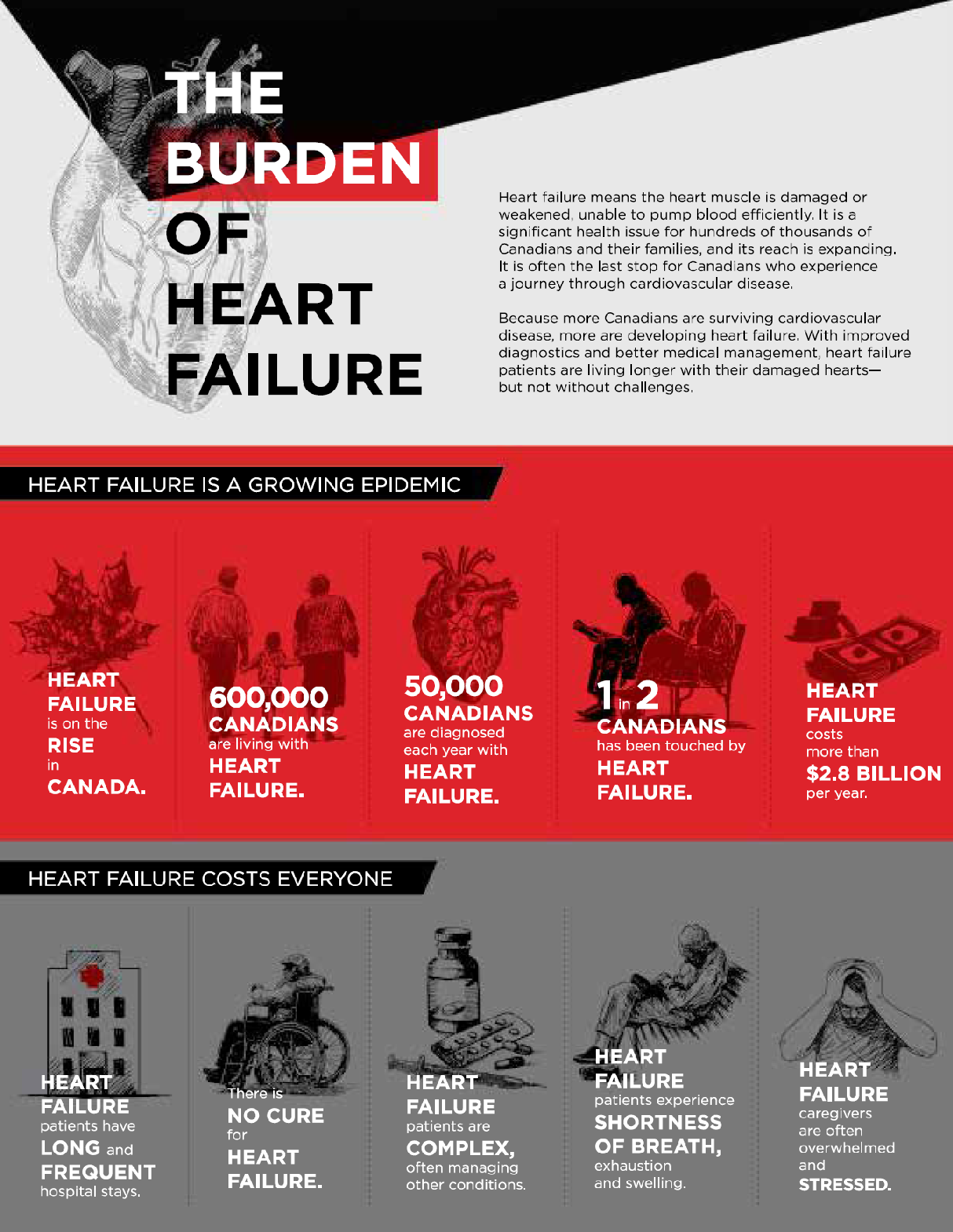

Slide 6
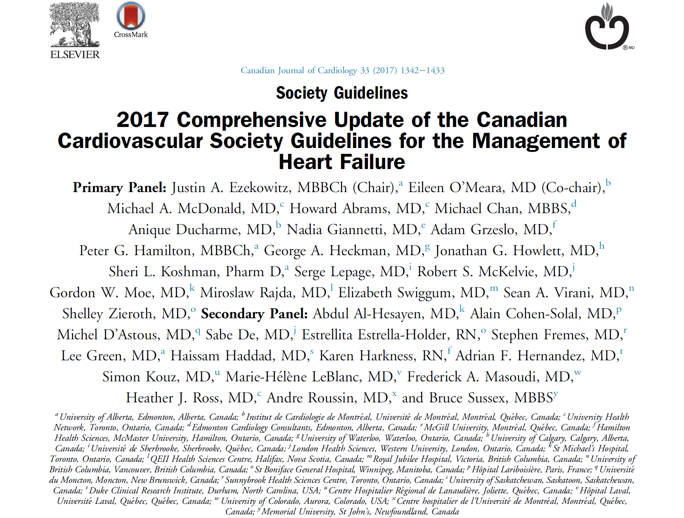

Slide 7
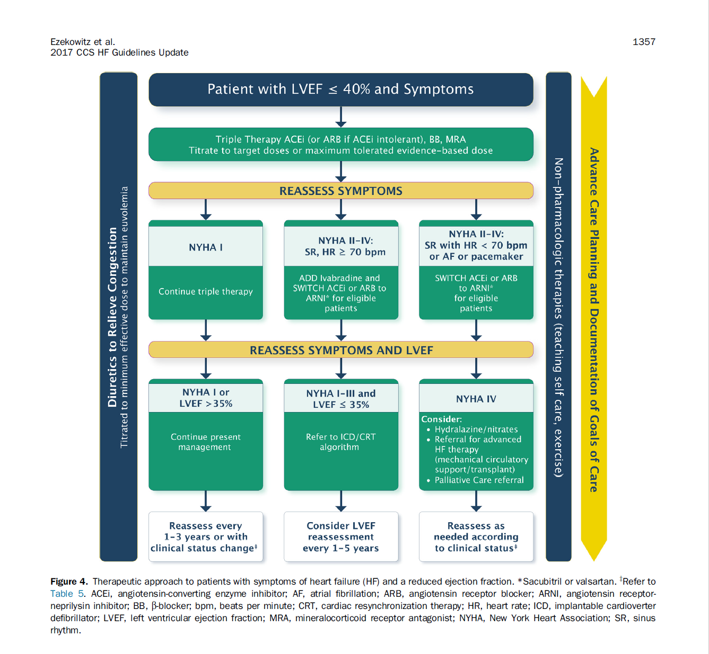

Slide 8
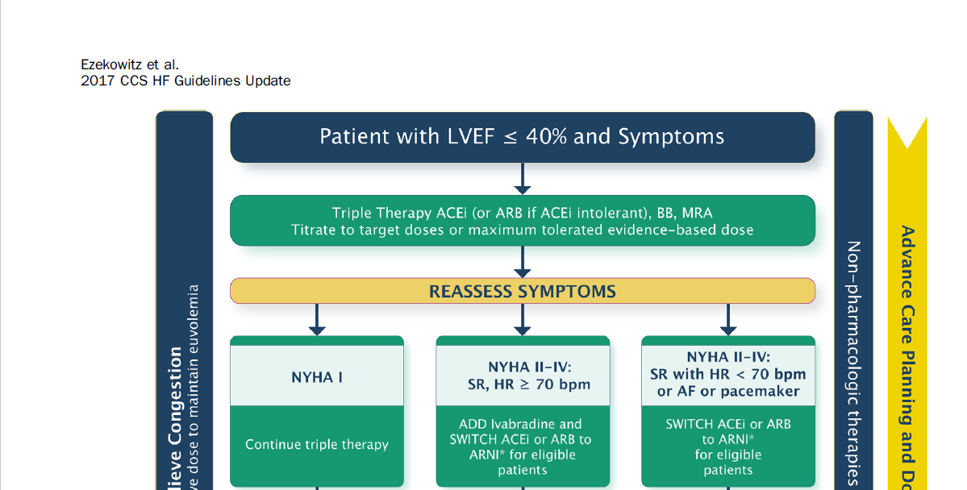
GDMT
Where is the Evidence?
There is no evidence for ACEi, BB* or MRA in the absence of background DIGOXIN therapy!!!
Unpublished CIBIS 2 data-no DIGOXIN interaction.

Slide 9
EBM: Is there any evidence for benefit of
C+D+E in the absence of baseline A+B therapy?
Trial Drug D
Trial Drug C
Baseline drug
A B
Trial drug
E
A+B = baseline standard of care
C validated on top of
  A (68-70%)+B (85%)
D validated on top of
  A (90%)+B (95%)+C (95%)
E validated on top of
  A (72-75%) +B (100%) +C(95%)+D (10%)

Slide 10
Digoxin and Diuretics Form the Evidence Base for Heart Failure Management
LVAD/TRANSPLANT
RAFT 35% on Digoxin
MADIT-CRT 27% on Digoxin
*Beta Blocker
*ACE inhibitors
Digoxin Diuretics
*Aldosterone antagonist
ENTRESTO
IVABRADINE
SGLT2 inhibitor
* Majority of study patients were on Digoxin
2010
CRT
2019
DAPA - HF 19% on Digoxin
2014
PARADIGM - HF 30% on Digoxin
2010
SHIFT 22% on Digoxin
2009
EMPHASIS 28% on Dig
1999
*RALES 72% on Digoxin
DIG Trial 1997
*COPERNICUS 65-76%
1996
*US Carvedilol 90%
on Digoxin
1991
*SOLVD 68%
on Digoxin
1987
*CONCENSUS
93% on Digoxin
The Incremental Evolution of HF Evidence 2019

Slide 11
Rx TRIALS | Primary Endpoint | Symptoms/ EF % | Control Dig % | Treatment Dig %
CONCENSUS | Mortality | IV/CXR ↑ LV | 94 | 92
SOLVD Trtmt | Mortality | I-IV/ < 35% | 68 | 66
US Carvedilol | Hosp. or Mort. | II-IV/ < 35% | 90 | 91
COPERNICUS | Hosp. or Mort. | III-IV/ < 25% | 65(all)/ 72 (decomp) | 72(all)/ 76 (decomp)
MERIT | Hosp. or Mort. | II-III/ ≤ 40% | 64 | 63
CIBIS-2 | Mortality | II-III/ ≤ 40% | 51 | 53
COMET | Mortality or Mort+ Hosp | II-IV/ < 35% | Metoprolol versus Carvedilol 59.5%
CHARM | Mortality | II-IV/ ≤40% | 43 | 42.7
RALES | Mortality | III-IV/ < 35% | 72 | 75
EMPHASIS | Hosp. or Mort. | II/ ≤ 30% | 28 | 27
SHIFT | Hosp. or Mort. | II-IV/ ≤ 35% | 22 | 22
PARADIGM | Hosp. or Mort. | II-IV/ ≤ 35% | 31 (enalapril) | 29(valsartan/ sacubutril)

Slide 12
Device Trials
DEVICE TRIALS | Primary Endpoint | Symptoms/ EF % | Control % | Treatment %
MADIT-CRT | Mort or HF | I-II/ ≤ 30% | 24 | 27
RAFT | Hosp. or Mort. | II-III/ ≤ 30% | 35 | 34

Slide 13
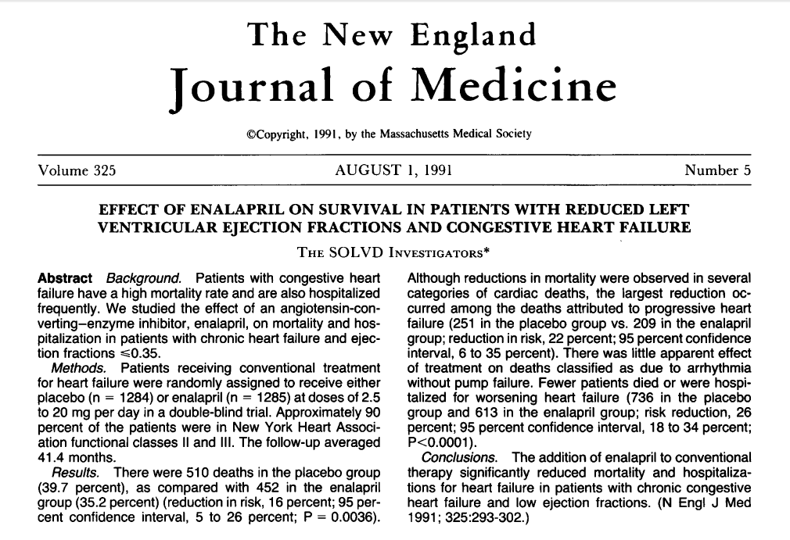



Slide 14
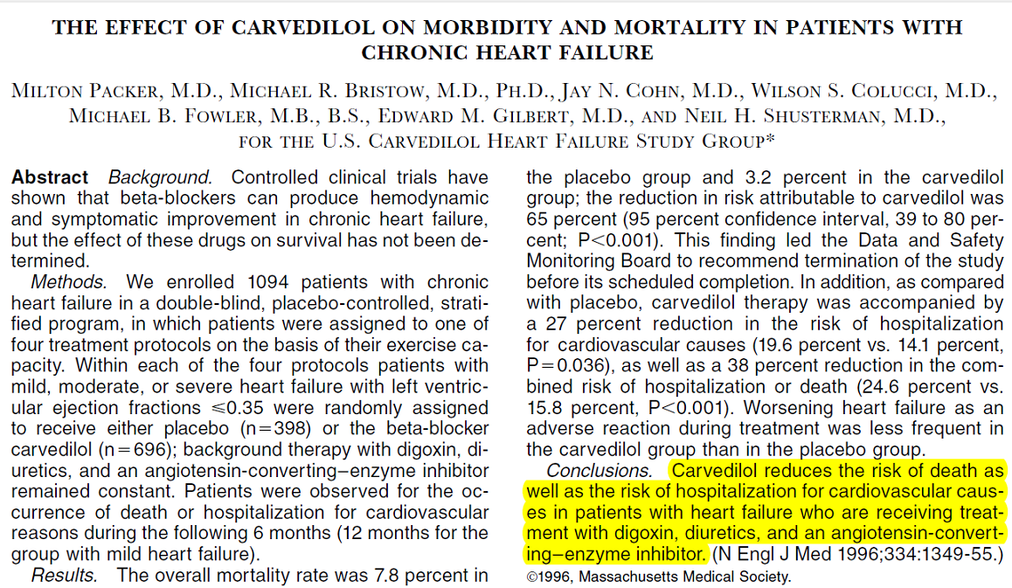
US Carvedilol Trial

Slide 15
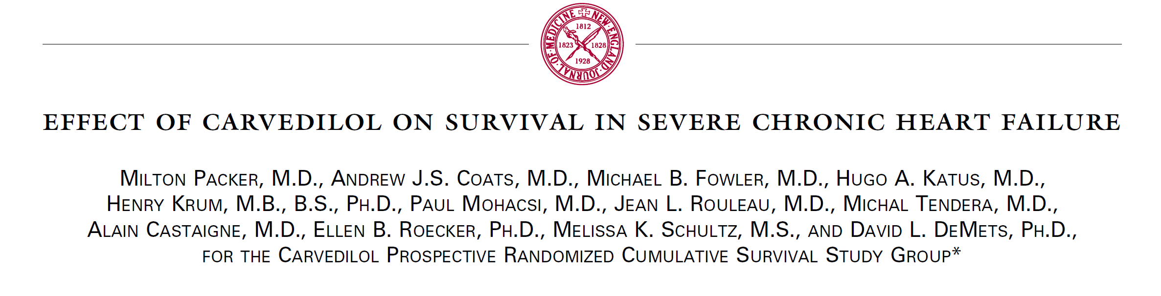
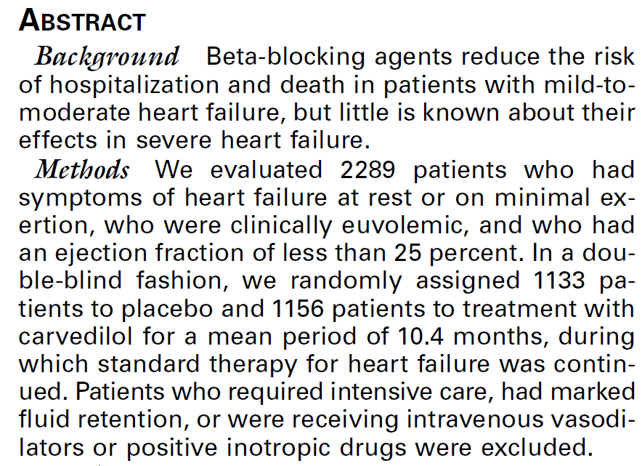





Slide 16
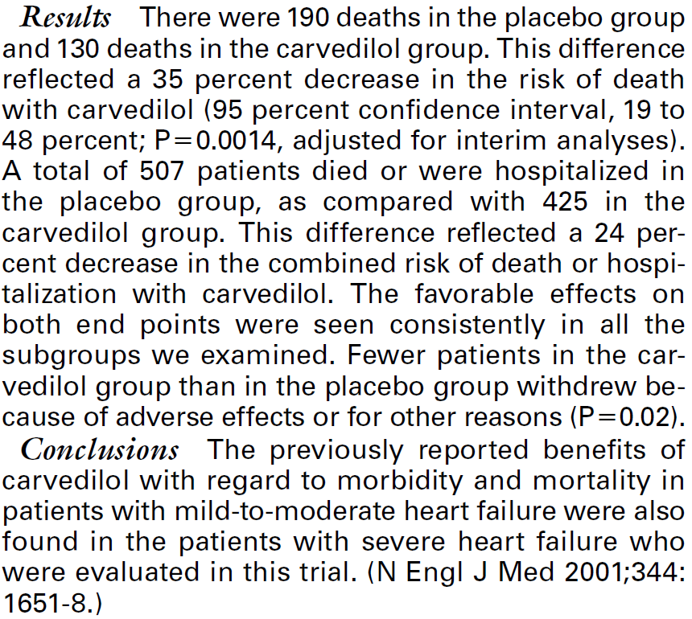

Slide 17
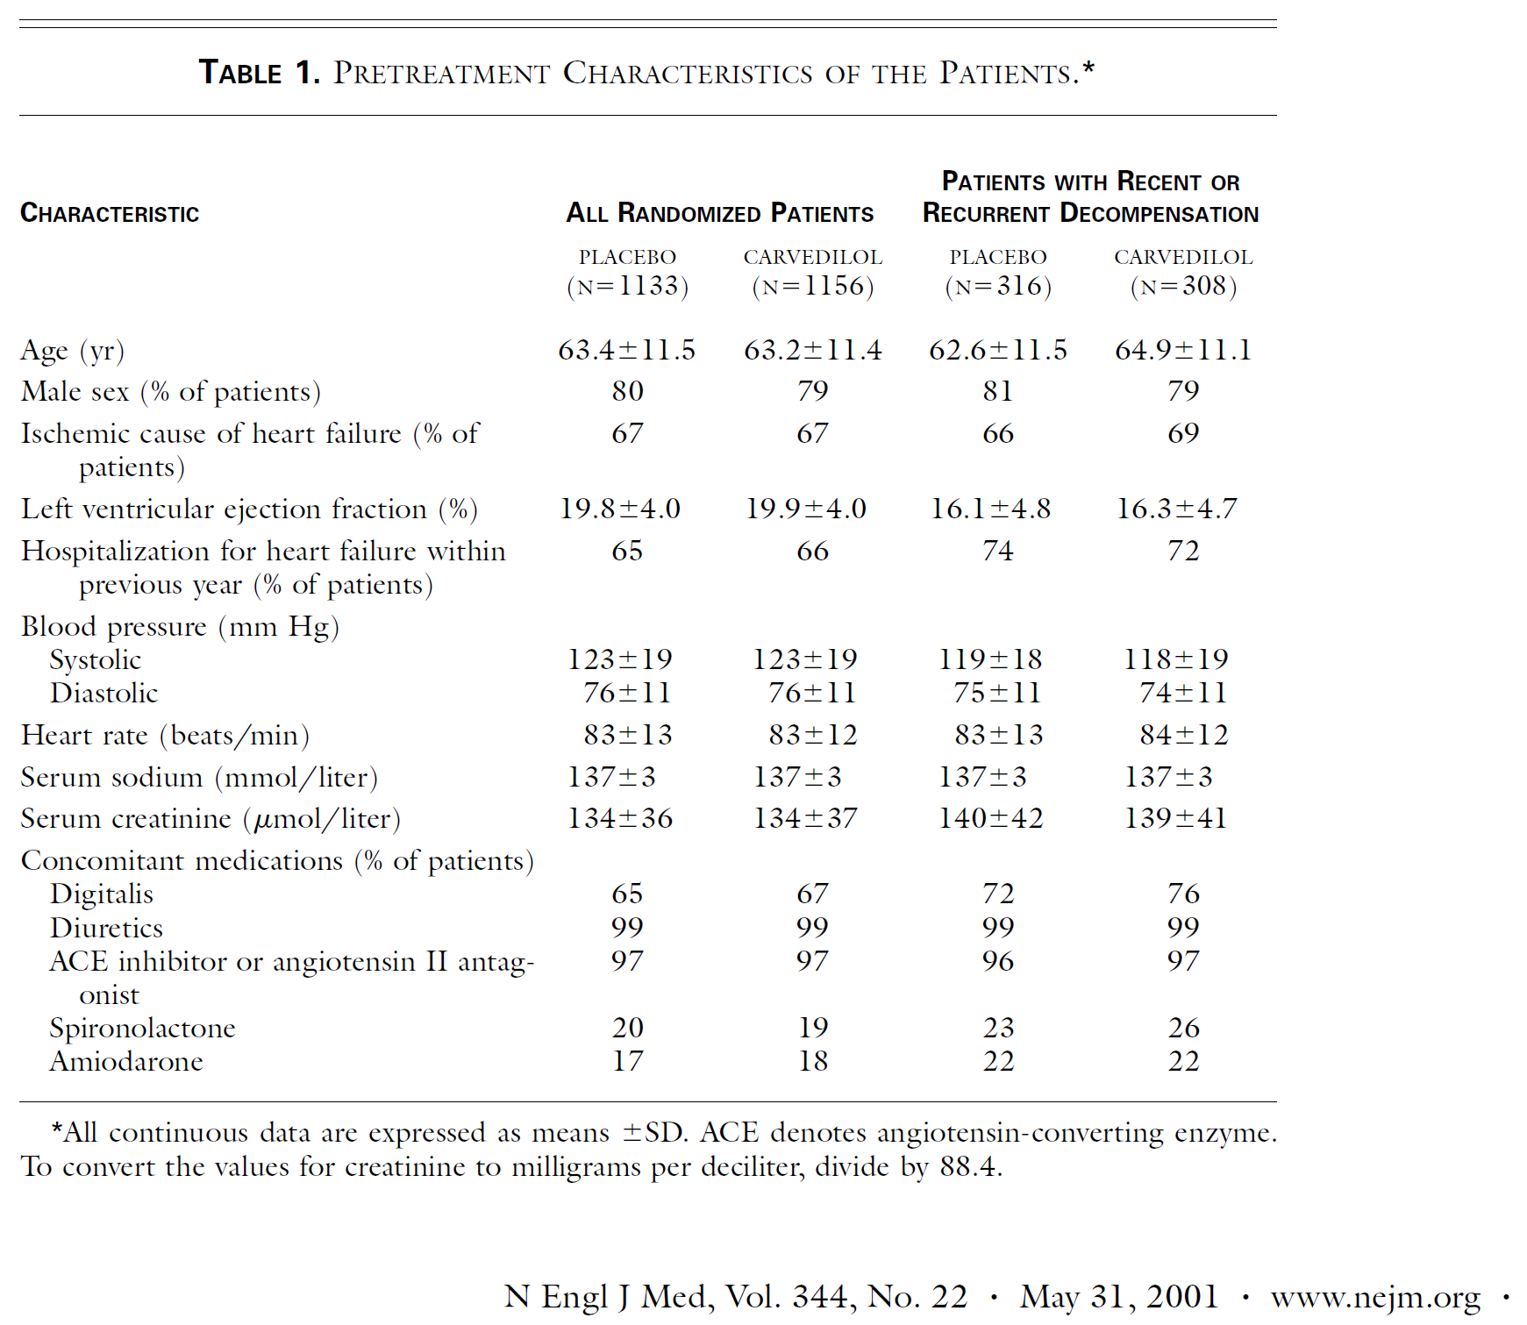
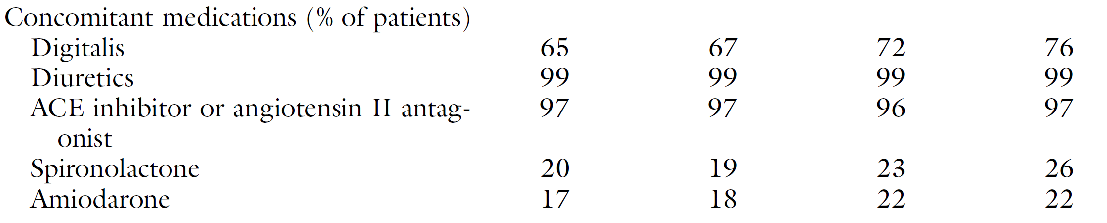
COPERNICUS Trial

Slide 18
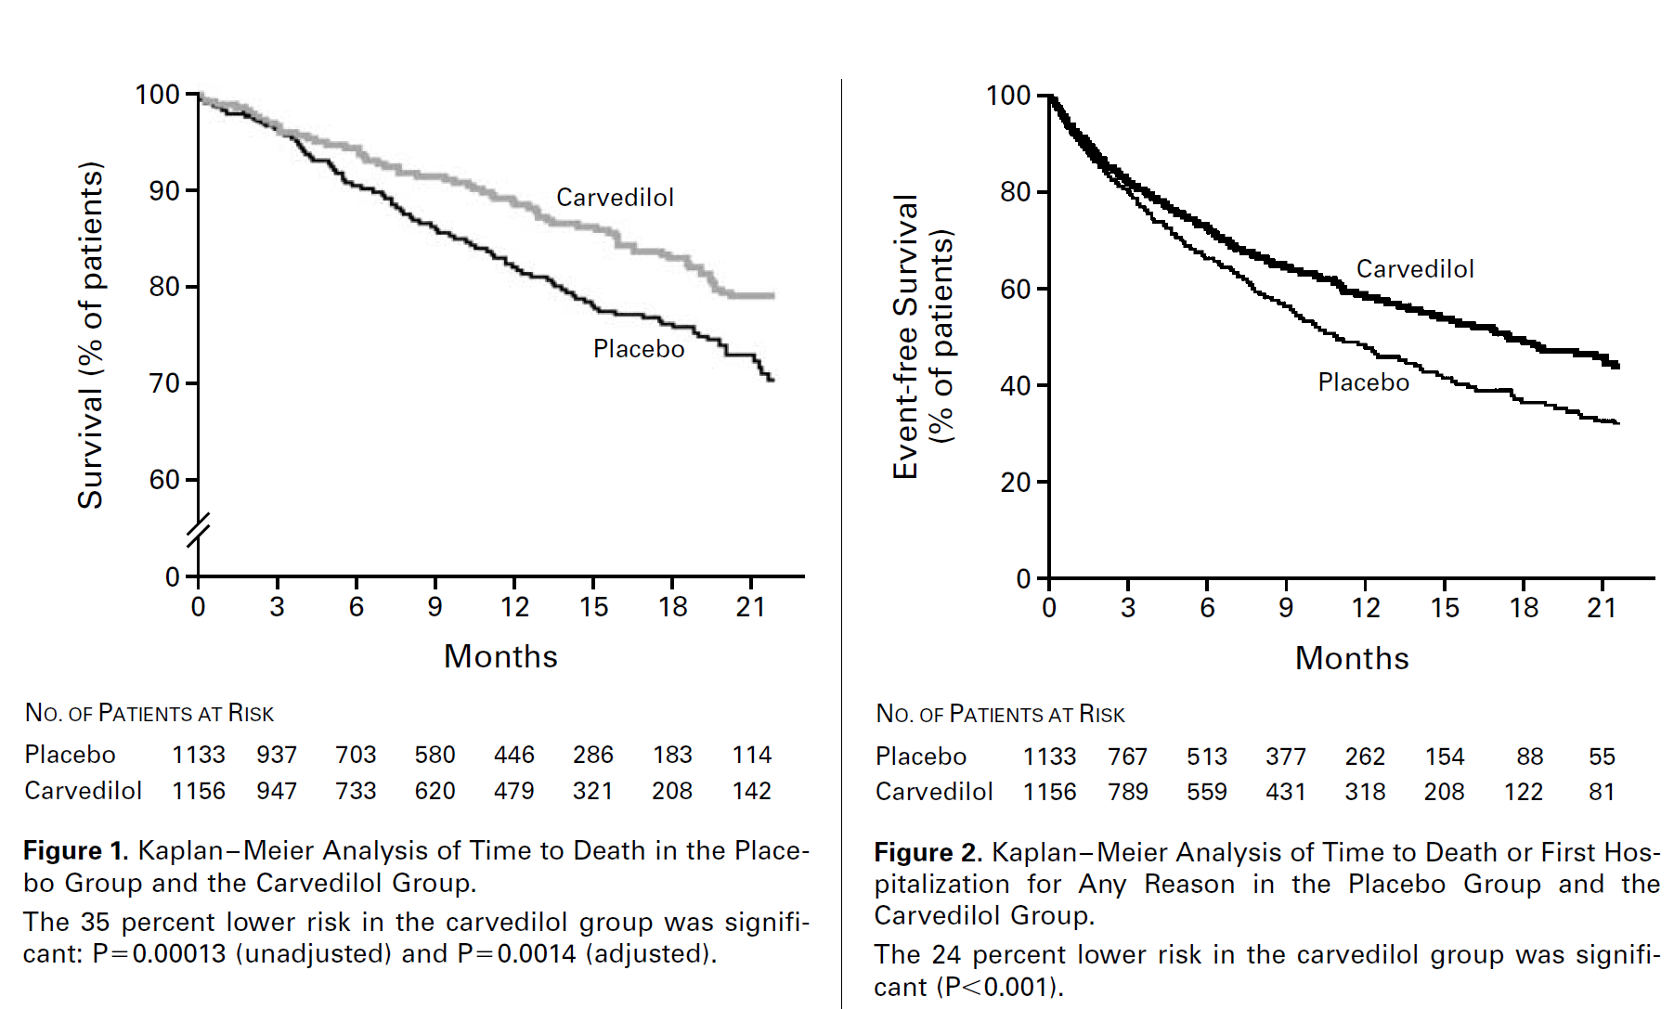
35%
24%

Slide 19
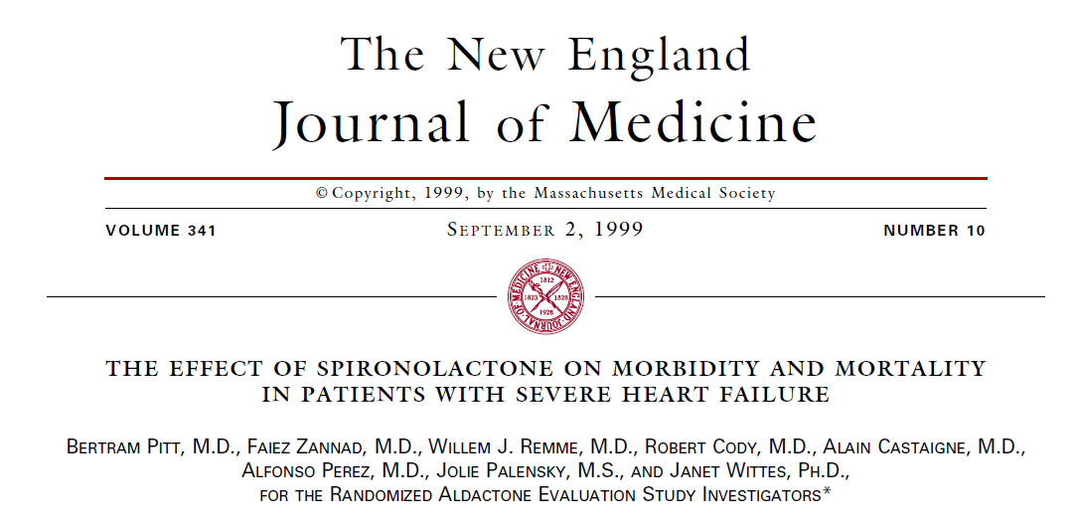
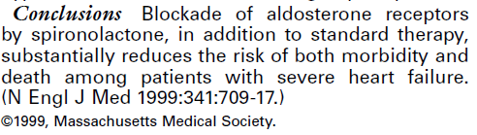

RALES

Slide 20
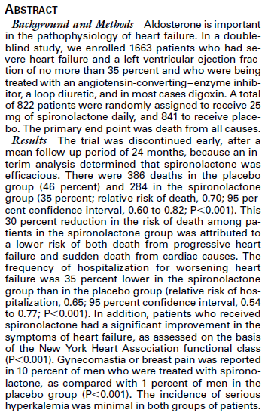

Slide 21
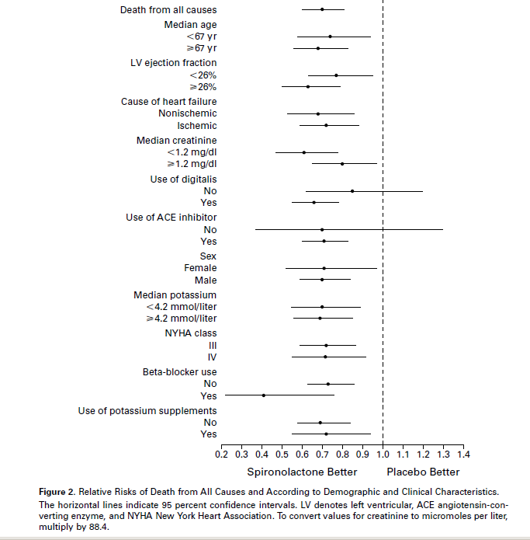
RALES:
Spironolac-tone of no benefit in the absence of Digoxin

Slide 22


Slide 23
Digoxin
Mechanisms of Action
Purified cardiac glycoside derived from Foxglove
Inhibits membrane bound Na⁺/K⁺ ATPase
Increases intracellular Ca⁺⁺
Augments CO
Increases EF
Reduces PCW
HR ↓ BP ↔
Prototypical neuro-hormonal modulator:
Increases carotid sinus baro-receptor sensitivity
Increases parasympathetic tone
Decreasing sympathetic and RAS activation
Reduces circulating NA
Reduces PRA
Releases ANP & BNP

Slide 24
Digoxin
Mechanisms of Action cont’d
Slows SA node firing
Prolongs AV nodal conduction
No pro-arrhythmic effect at therapeutic SDC
At supra-therapeutic SDC or therapeutic SDC with hypokalemia →AV block, escape rhythms, accelerated junctional rhythm
Only orally active positive inotrope that does not increase mortality.!!!

Slide 25
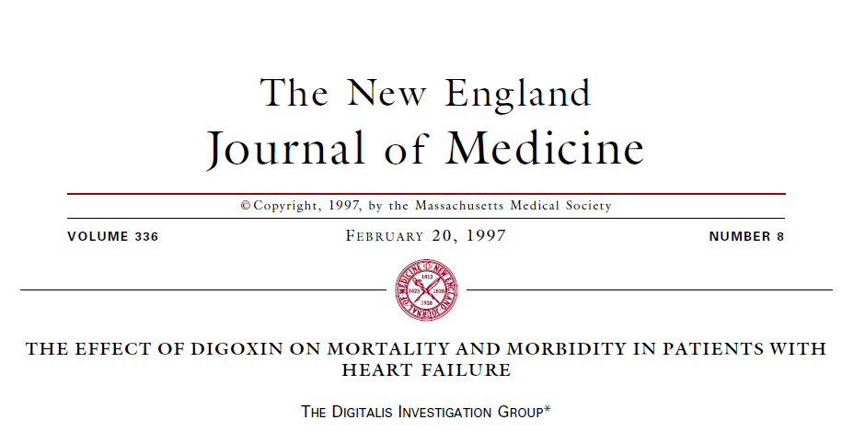
At its peak Digoxin was Rx in ~ 80% of HF patient

Slide 26
THE EFFECT OF DIGOXIN ON MORTALITY AND MORBIDITY IN PATIENTS WITH HEART FAILURE
Digoxin Investigators Group
N Engl J Med 1997;336:525-33
Eligibility: HF and EF < 45%
  54% class II and 31% class III
  Placebo 3403 vs Digoxin 3387
  Suspected Dig toxicity Placebo 1% vs 2%
Overall mortality neutral: Dig 34.8% vs Pl 35.1%
Hospitalizations 6% (absolute) ↓ Dig group (NNT 16.6)
Hospitalizations for worsening HF:
  8% (absolute) ↓ in Dig group (NNT 12.5)
  Placebo 34.7% vs Digoxin 26.8% (38% RRR)
There was no significant difference between the groups in the number of patients hospitalized for ventricular arrhythmia or cardiac arrest (142 vs. 145).

Slide 27
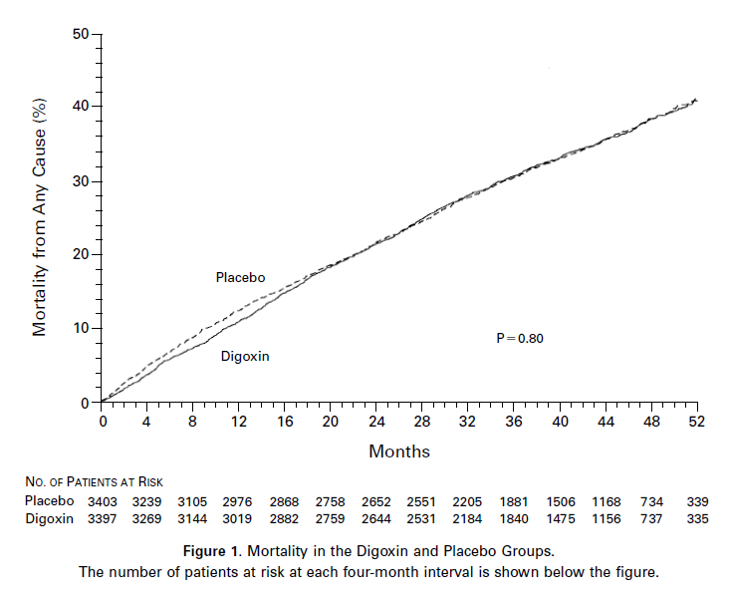

Slide 28
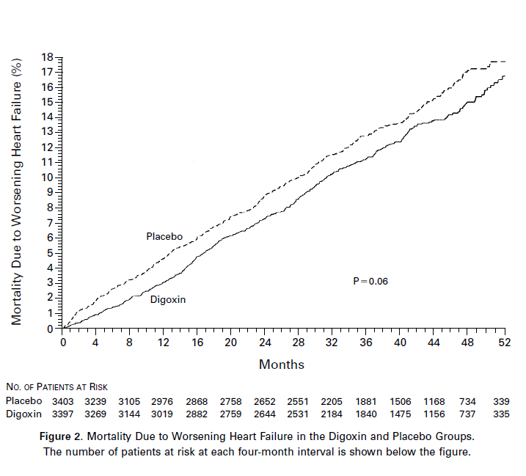

Slide 29
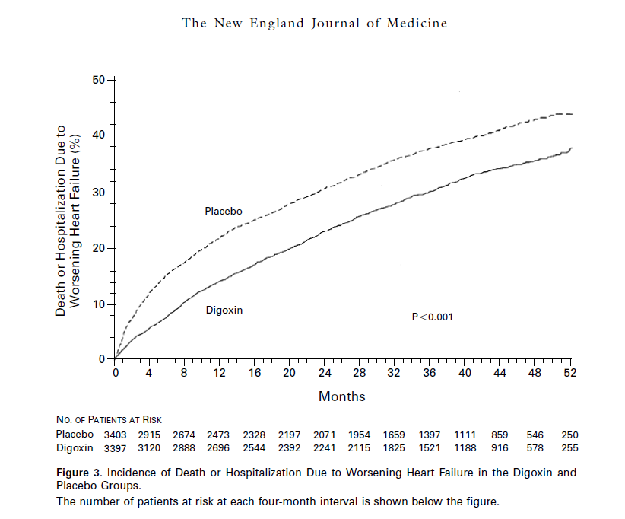
15%↓

Slide 30
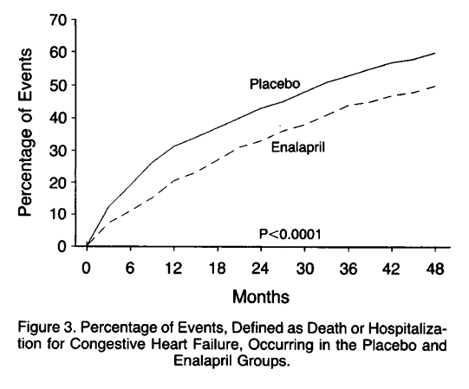
SOLVD
Death or Hospitalization
26% ↓

Slide 31
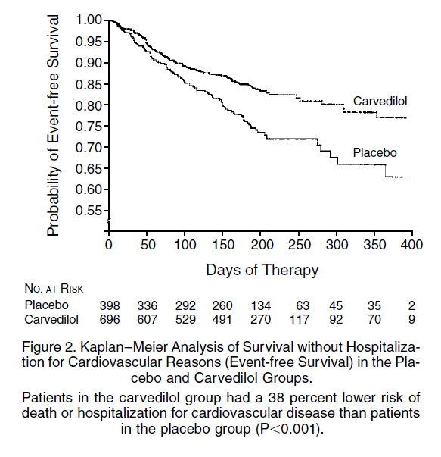
US Carvedilol
Death or Hospitalization
38%↓

Slide 32
COPERNICUS
35%↓
24%↓

Slide 33
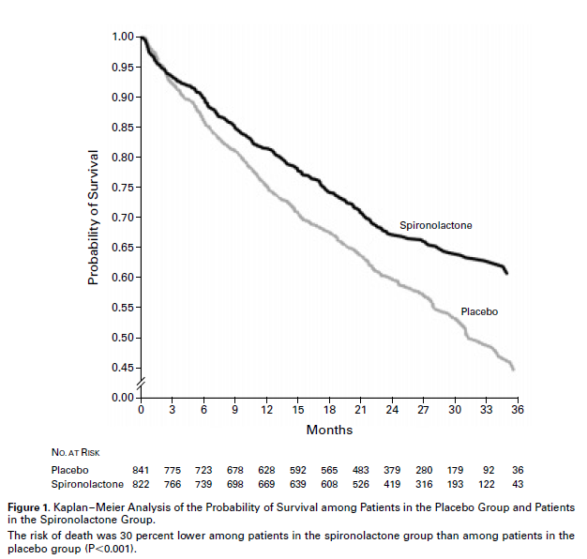
RALES
Mortality
30%↓

Slide 34
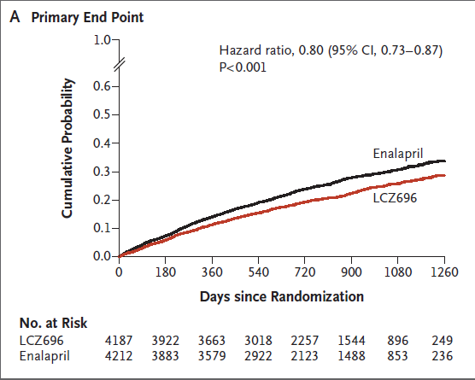
PARADIGM
Death or Hospitalization
30%↓

Slide 35
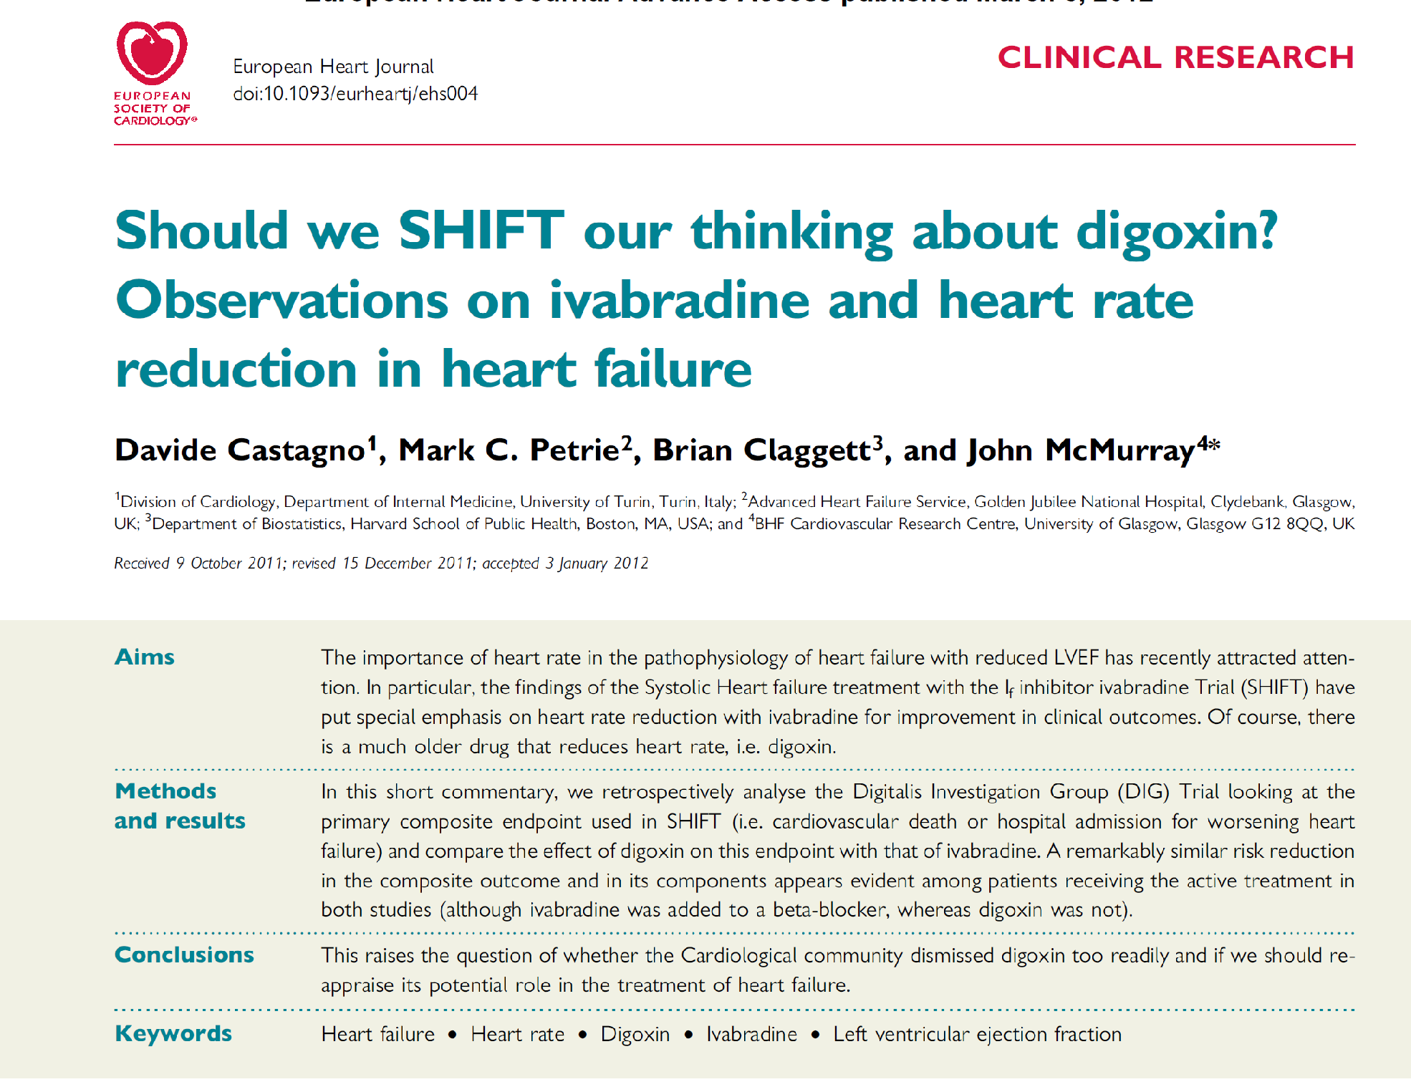

Slide 36
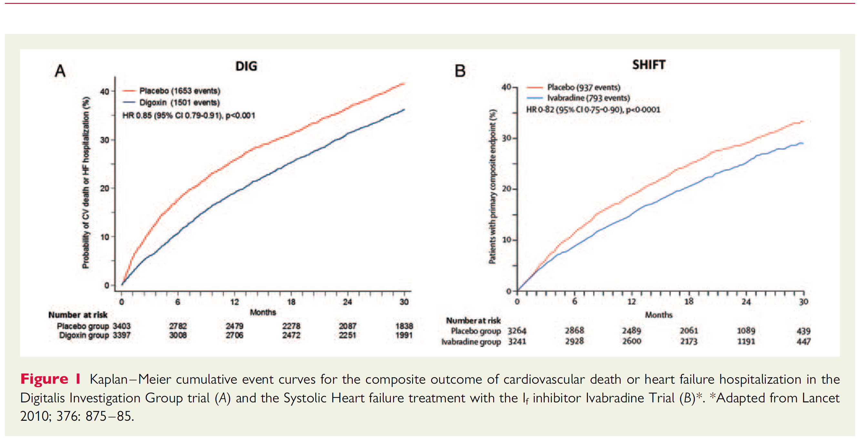
DIG Trial /SHIFT Trial
Comparable Endpoints

Slide 37
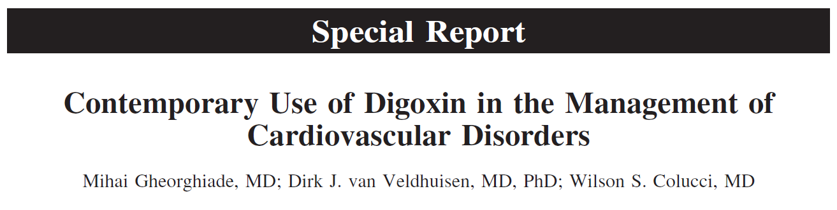
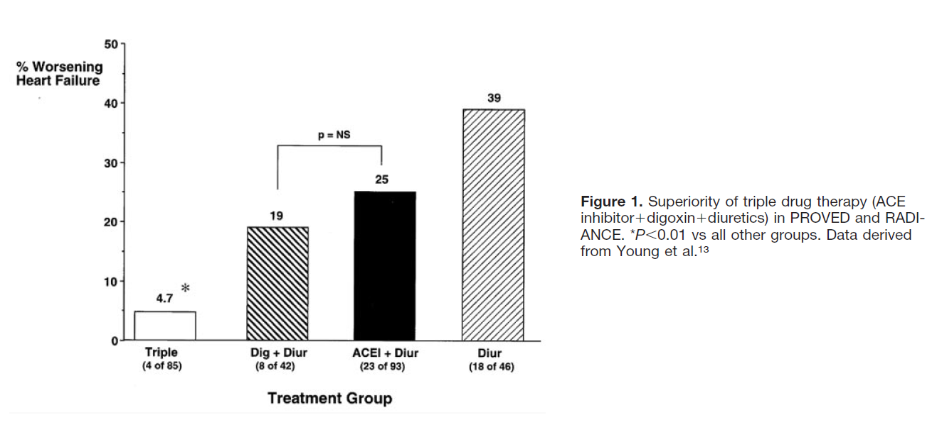

Slide 38


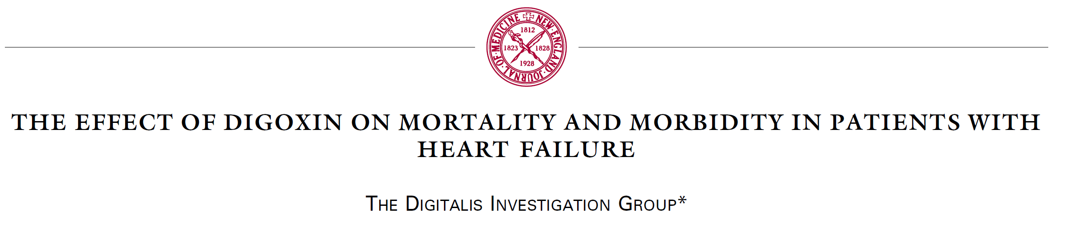
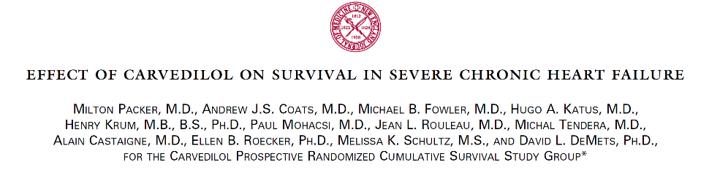
Let’s compare Apples to Apples
DIG Trial COPERNICUS
EF < 25%
Prespecified subset
EF < 25%
Entry criteria

Slide 39
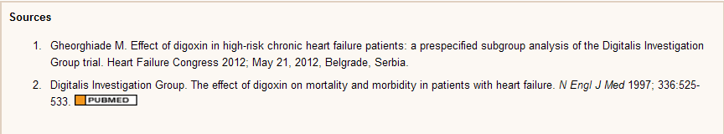
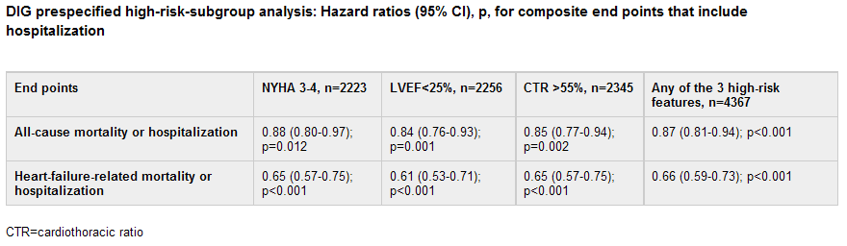
DIG Trial Benefits in
High Risk Groups

Slide 40
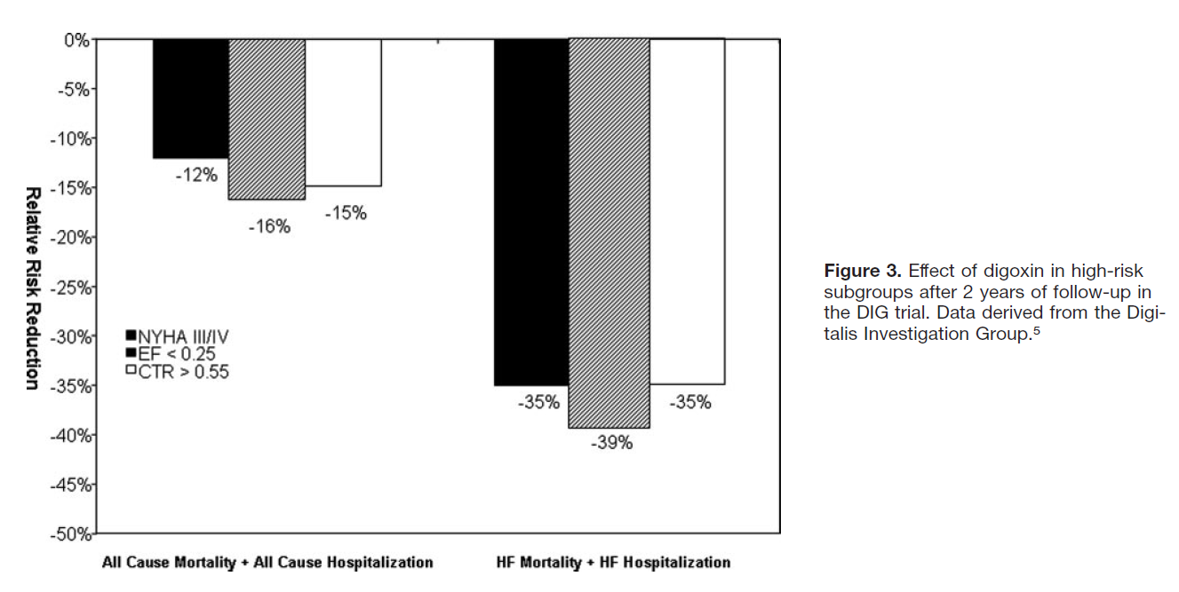

Slide 41
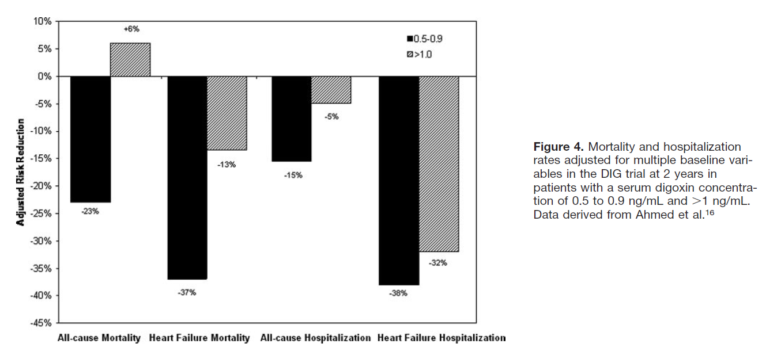

Slide 42
COPERNICUS vs DIG
DIG
23%↓ all cause MR
37% ↓ HF MR
DIG
15% ↓all cause Hospz
38% ↓ HF Hospzn
35%↓
24%↓

Slide 43
COPERNICUS vs DIG Trial
Subset EF < 25%
Event reduction identical
COPERNICUS data accrued on top of Digoxin
No data of Carvedilol benefit in advanced HF in the absence of Digoxin
DIG trial accrued its data in the absence of Carvedilol

Slide 44
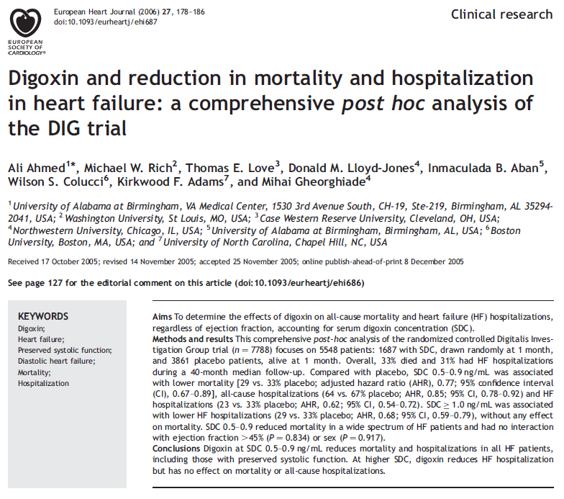

Slide 45
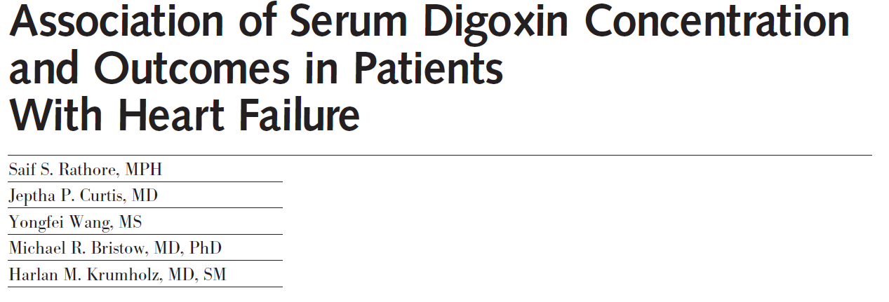
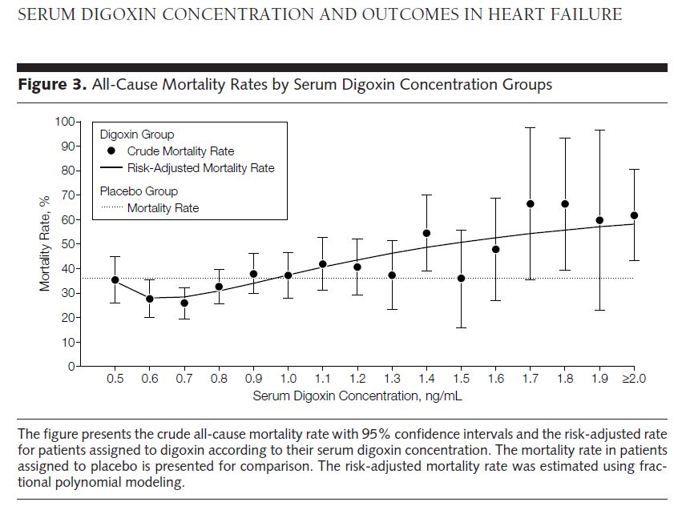
JAMA Feb 29 2003 871-878.

Slide 46
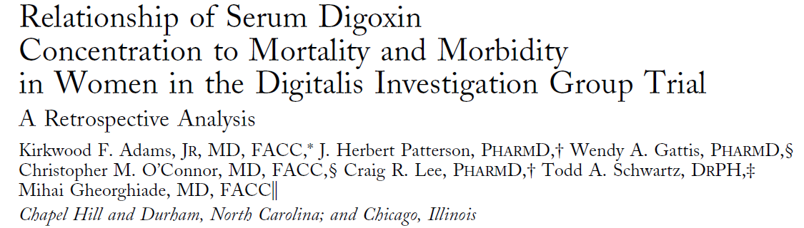
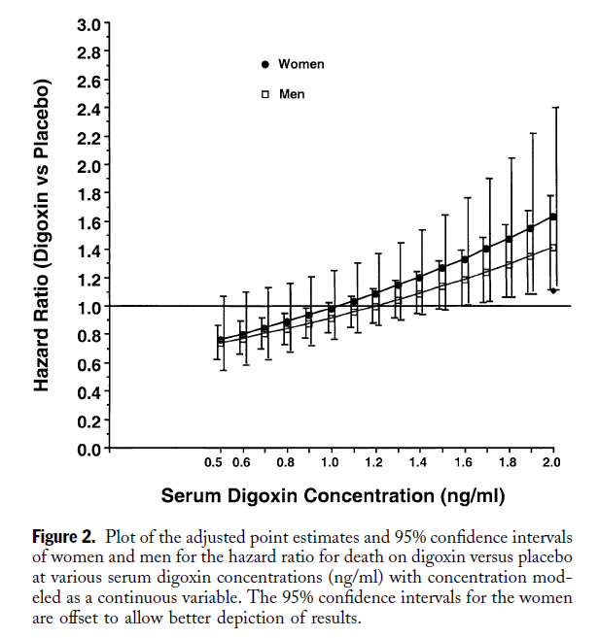

♂♀
Journal AmCollCardiol
2005;46:497–504)

Slide 47
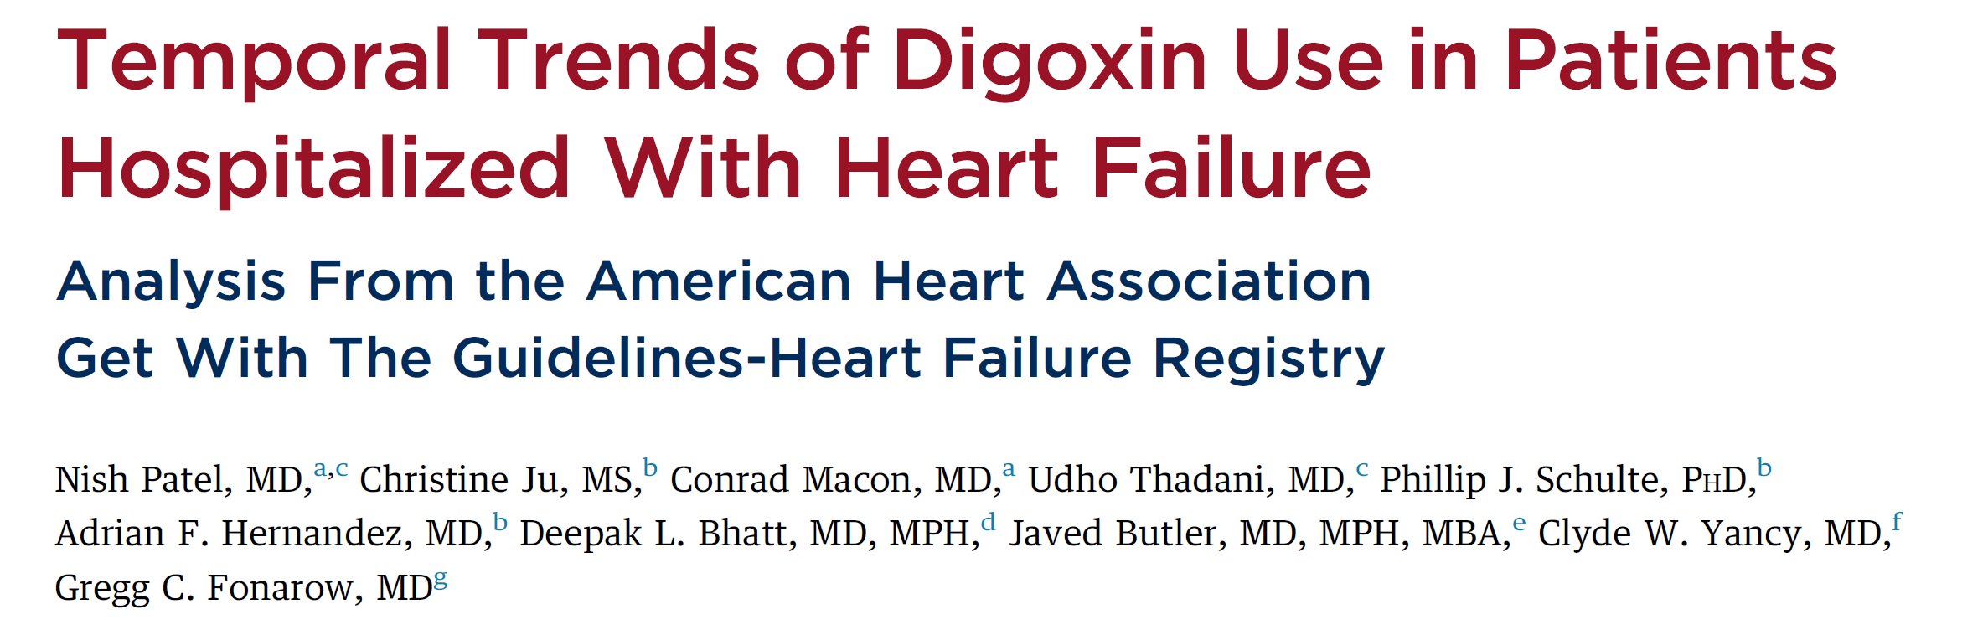

Slide 48
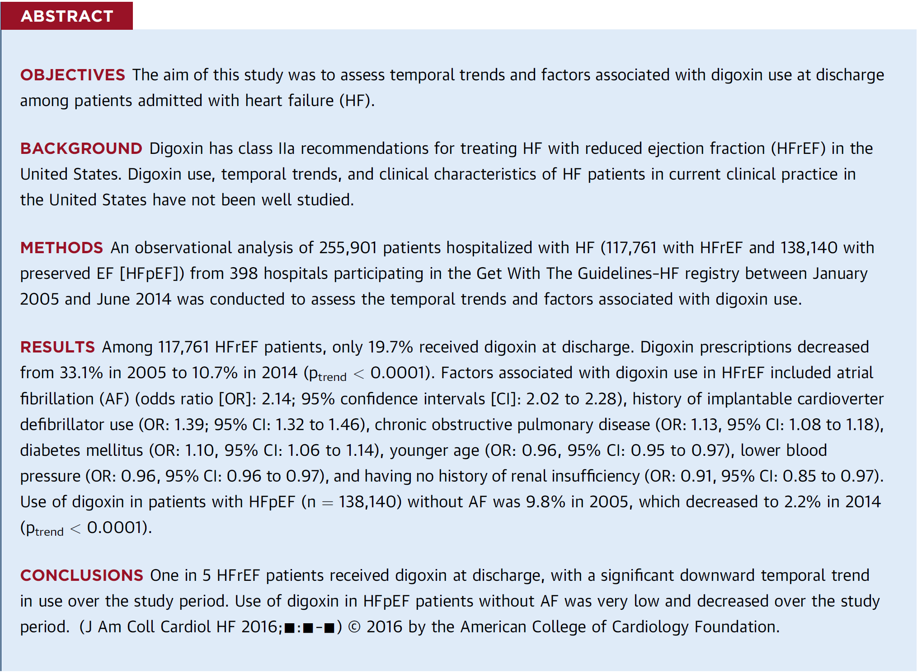

Slide 49
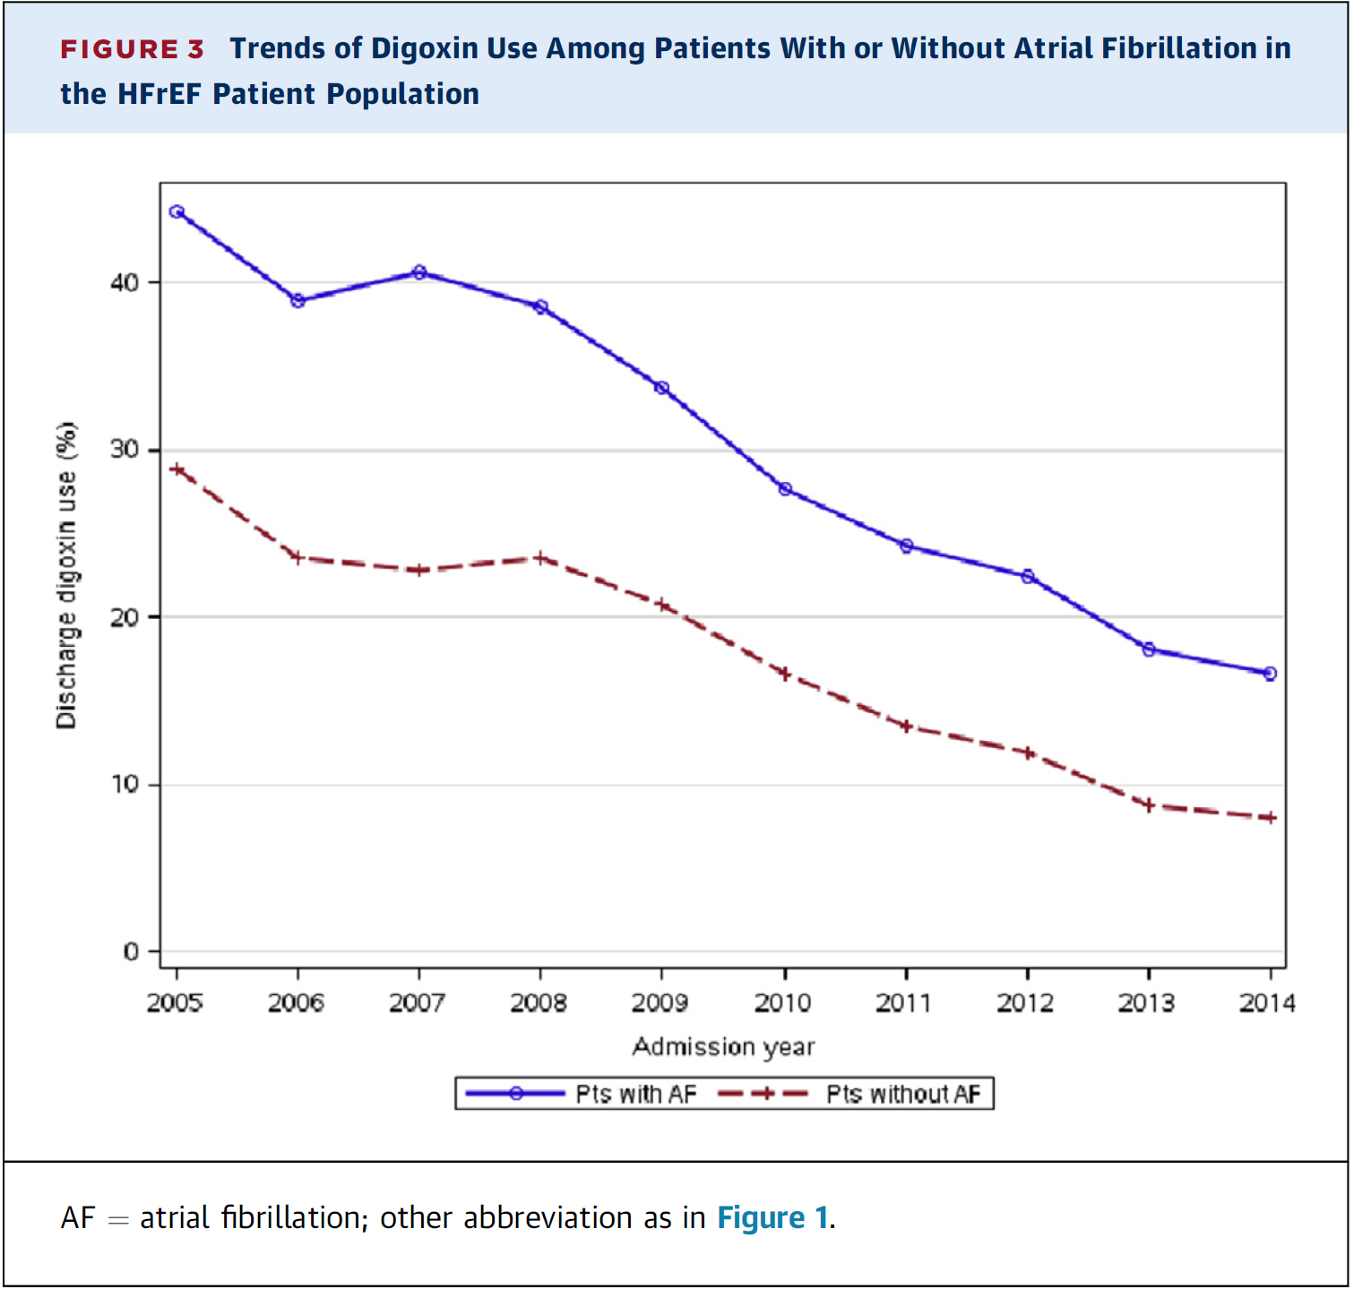

Slide 50
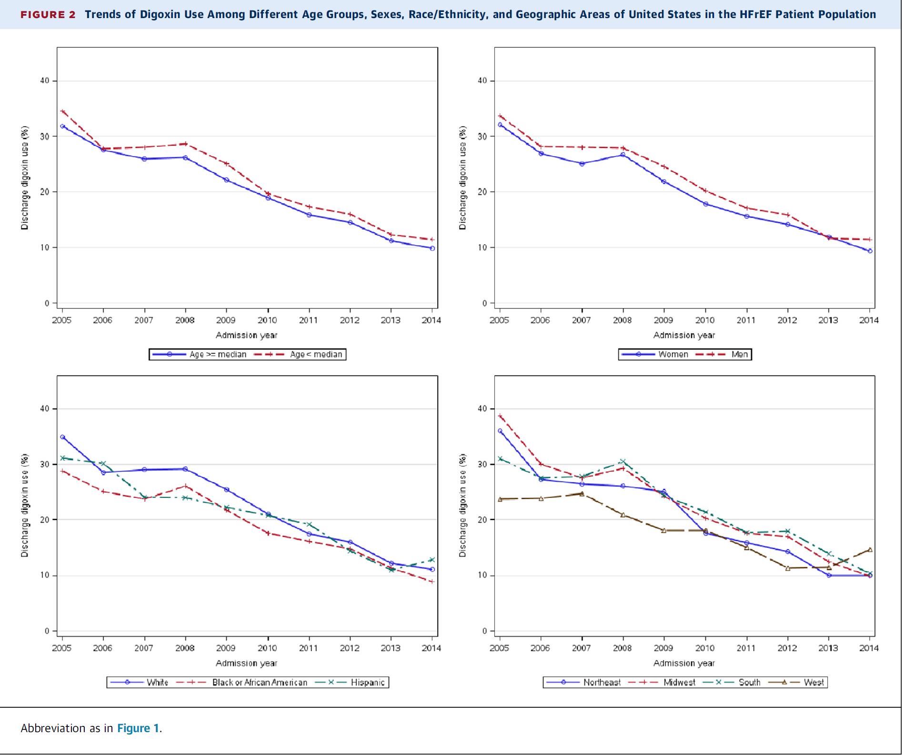

Slide 51
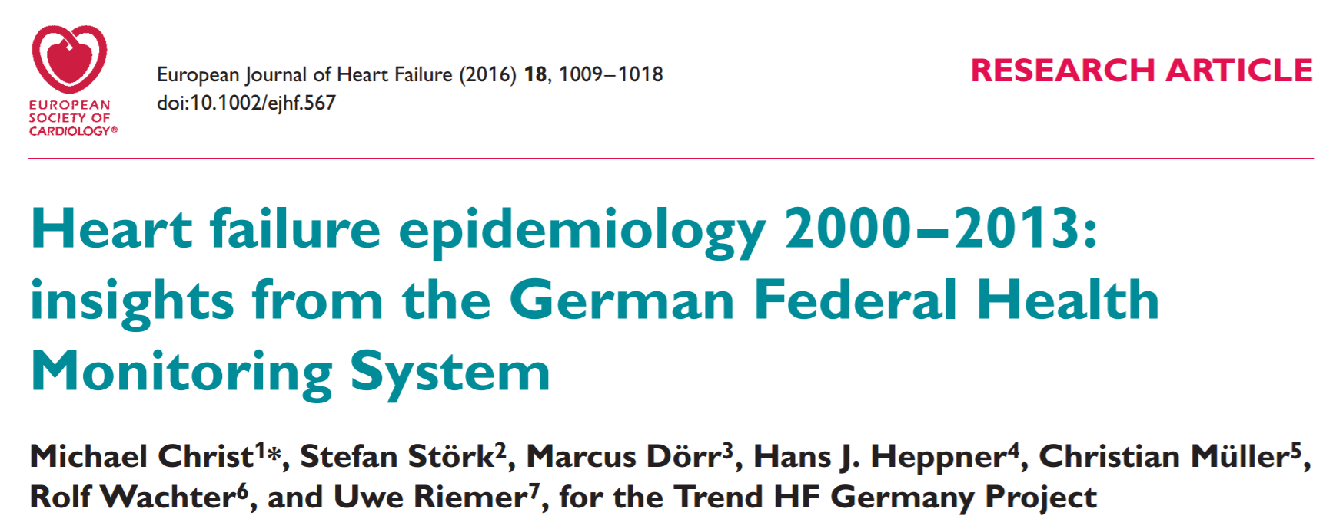
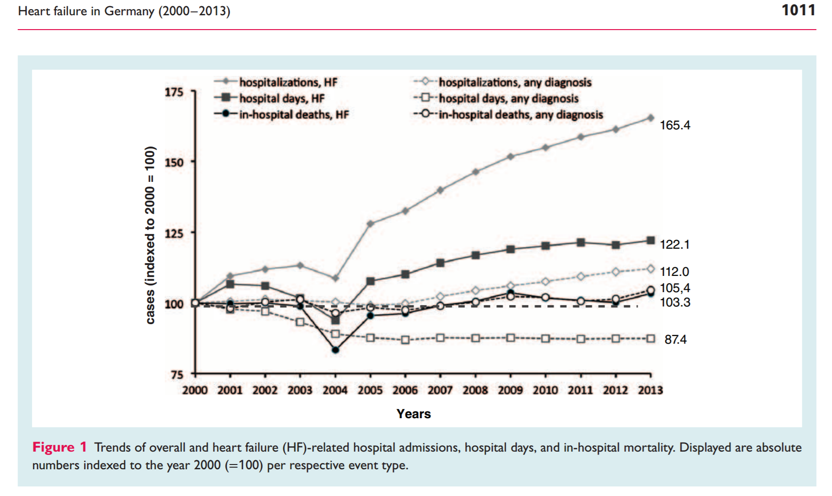

Slide 52
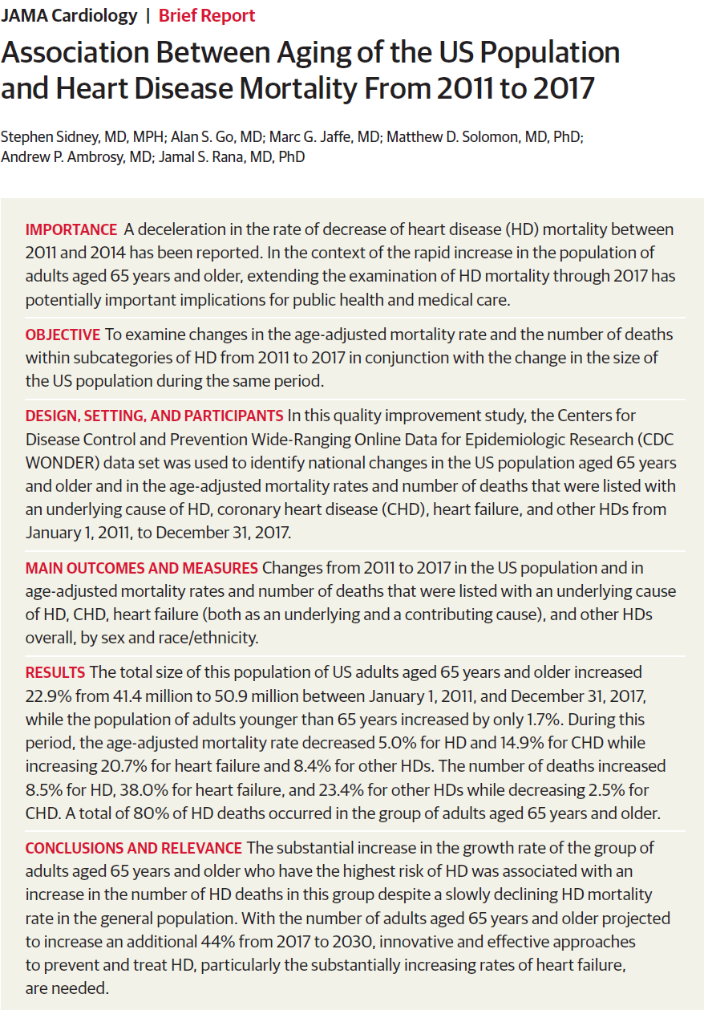


Slide 53
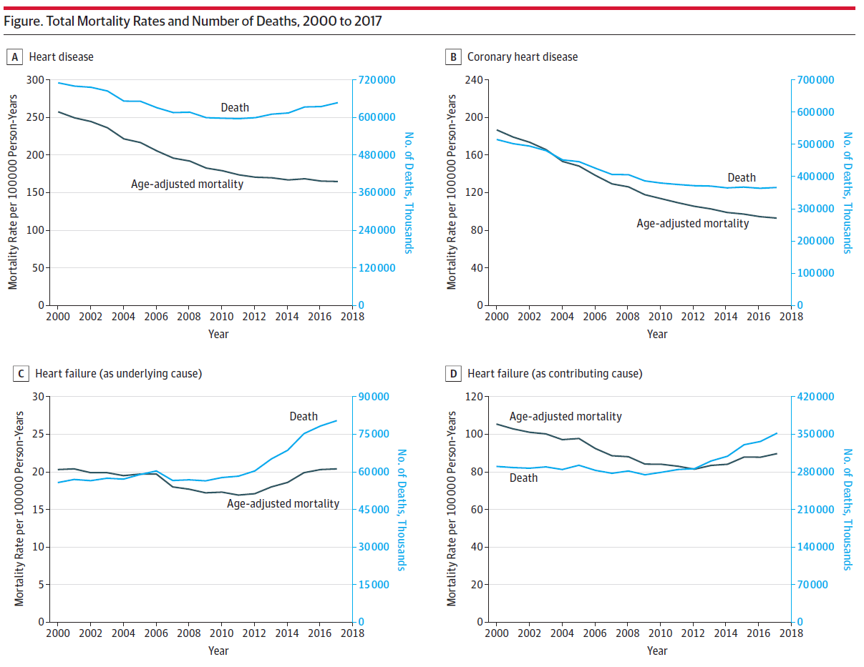

Slide 54


Slide 55
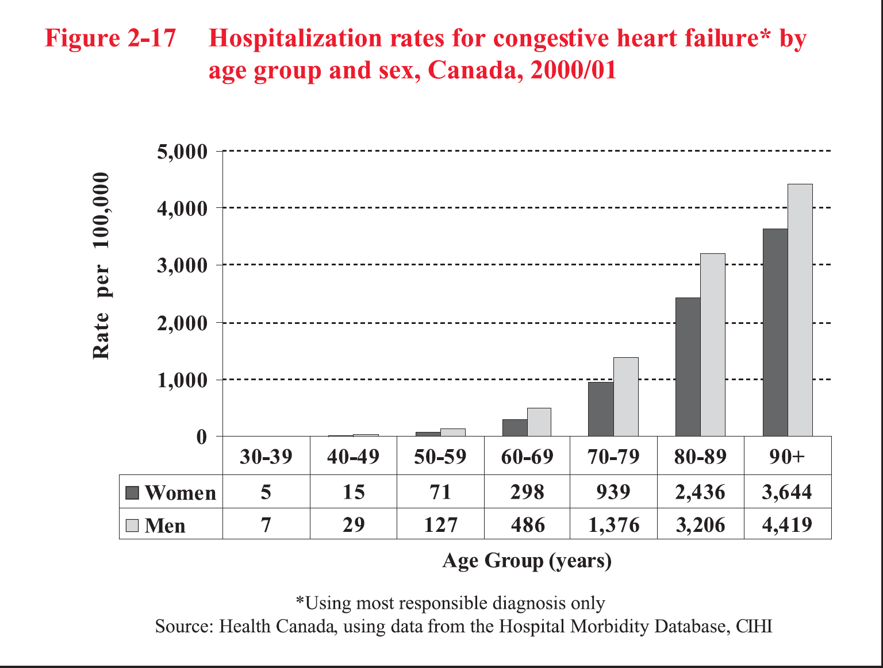

Slide 56
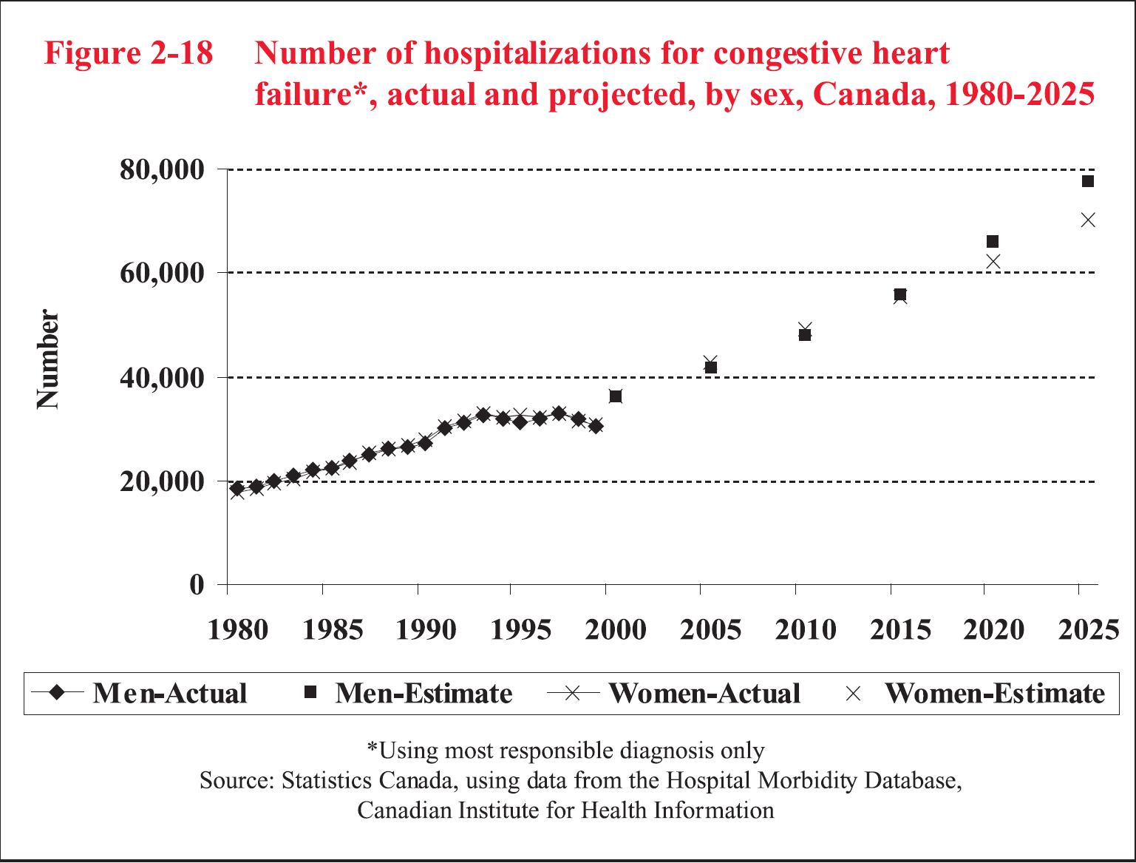

Slide 57

Digoxin and Diuretics Form the Evidence Base for Heart Failure Management
GDMT without Digoxin
The Devolution of HF Evidence

Slide 58


Slide 59



Slide 60


Slide 61



Slide 62




Slide 63


Slide 64


Slide 65


Slide 66


Slide 67

Digoxin in Diastolic Heart Failure

Slide 68


Slide 69


Slide 70


Slide 71


Slide 72


Slide 73






Research Context:
‘’A Controversial Topic’’

Slide 74

Baseline Digoxin and Adjusted Mortality
Baseline Serum Digoxin Concentration and Adjusted Mortality
<0.9 ng/mL
N=3373 (76%)
Adj. HR (95% CI):
1.00 (0.85–1.16)
P=0.956
≥0.9 to <1.2 ng/mL
N=559 (12.6%)
Adj. HR (95% CI):
1.16 (0.87–1.55)
P=0.322
≥1.2 ng/mL
N=499 (11.4%)
Adj. HR (95% CI):
1.56 (1.20–2.04)
P=0.001
Adj. HR (95% CI):
1.09 (0.96–1.23)
P=0.191

Slide 75

Adjusted Mortality by Digoxin Concentration
Adj. HR (95% CI):
1.19 (1.07–1.32)
P=0.001
for each 0.5 ng/mL increase in baseline digoxin concentrations

Slide 76


Slide 77


Slide 78


Slide 79


Slide 80


Slide 81

Digoxin in Right Heart Failure

Slide 82


Slide 83


Slide 84


Slide 85


Slide 86



Slide 87
Digoxin Use: Conclusions
Digoxin use was baseline therapy for current “triple HF therapy” evidence
There is no evidence for contemporary HF therapy in the absence of Digoxin
Digoxin reduces HF hospitalization with neutral effect on mortality
In select cases: Class III-IV, low EF or Dig level < 1.0 ng/mL (HFrEF and HFpEF), Digoxin reduces HF mortality

Slide 88
Digoxin Summary
Digoxin forms the baseline of all evidence based HF therapy
There is no evidence for ACE inhibition, beta blockade or use of spironolactone in the absence of digoxin
Digoxin is well tolerated, lowers HR, has no impact on BP or renal function

Slide 89
Digoxin Use: Conclusions
Digoxin levels < 1.2 ng/mL are statistically safe
Eliminating Digoxin from the treatment of Class III-IV heart failure is NOT EVIDENCE BASED
Digoxin is necessary to buttress LV function and allow patients to tolerate “evidence based doses” of ACEi, BB or MRA

Slide 90
Digoxin Summary
Digoxin is mortality neutral in HF
Digoxin reduces hospitalization and death combined endpoint in HF
Digoxin withdrawal increases mortality
Digoxin reduces mortality and hospitalization in HF patients with low EF or with SDC < 0.9 ng/mL
Digoxin use saves $$$

Slide 91
Digoxin Summary
Underuse of digoxin has been driven by misrepresentation of the evidence
Underuse of digoxin is driving HF admissions and readmissions
An entire generation of physicians has been trained falsely to avoid digoxin or use it as a last resort

Slide 92
How to Dose Digoxin
Safely for HF
Administer orally for chronic HF-No need loading dose unless rapid atrial fibrillation
Suggested dosing:
  Patient ≤ age 70 with normal renal function Rx 0.25 mg daily
  Patient > 70 or with mildly impaired renal function Rx 0.125 mg daily
  Patient > 70 with moderately impaired renal function or low body weight Rx 0.0625 mg daily or every 2nd day
  Use with caution in severe renal impairment
Monitor digoxin levels at 7-14 days and maintain level 0.5-0.7 ng/mL for arrhythmia safety

Slide 93

Use DigCalc to Estimate
Trough Digoxin levels
Use only the CHF calculator [even for AFIB]
Factor in a 30% safety margin

Slide 94


Target trough Digoxin level for 30% safety margin

Slide 95
Two Pre-Discharge Interventions Will Change the Face of HF Management and Outcome
Digoxin for HF with EF < 35%
  Monitor and maintain digoxin levels < 1.0 ng/ml
Use appropriate β-blocker dosing in the elderly
  β-blocker initiation but AVOID FORCED IN-PATIENT TITRATION
  Down titration for worsening HF
  Avoid in severe AS/MR/AR/PHTN/RHF
    No evidence of outcome benefit

Slide 96


Slide 97


Slide 98



Slide 99

Beta blocker Dose Equivalents

Slide 100
Beta Blocker Dosing in the Elderly
 | Metoprolol | Bisoprolol | Atenolol | Carvedilol
Low | 12.5 mg BID | 1.25 mg OD | 12.5 mg OD | 3.125 mg BID
Intermediate | 25 mg BID | 2.5 mg OD | 25 mg OD | 6.25 mg BID
Standard | 50 mg BID | 5.0 mg OD | 50 mg OD | 12.5 mg BID
High | > 50 mg BID | > 5.0 mg OD | > 50 mg OD | 25 mg BID
Excessive | > 100 mg BID | > 10 mg OD | > 100 mg OD | > 25 mg BID

Slide 101


Slide 102
DISABUSE Scale
Drug Implementation Strategy for Appropriate Beta-blocker USe in the Elderly

Slide 103
DISABUSE Scale
Age 65-70: Maximum 50 mg BID metoprolol or equivalent.
Age 70-75: Maximum 37.5 mg BID metoprolol or equivalent.
Age 75-80: Maximum 25 mg BID metoprolol or equivalent.
Age 80-85: Maximum 12.5 mg BID metoprolol or equivalent.
Above age 85: Maximum 12.5 mg OD metoprolol or equivalent (or none).

Slide 104

CVToolbox Downloads http://www.cvtoolbox.com/downloads/downloads.html

Slide 105

Heart Failure Tool

Slide 106

Diuretic Titration
Tool

Slide 107
Lasix Edema Grading Scale (LEGS) Scale
Edema to ankles: Furosemide 20 mg daily
Edema to mid shin: Furosemide 40 mg daily
Edema to knees: Furosemide 60 mg daily
Edema to mid thigh: Furosemide 80 mg daily
Double diuretic dose to BID if renal failure
Add low dose spironolactone 12.5 – 25 mg for persisting symptoms and mortality reduction
  Target K 4.0-5.5
Reserve ascending limb diuretic for refractory HF, anasarca-under cardiology supervision

Slide 108


Heart Failure Guide

Slide 109

Beta Blocker HF TitrationTool

Slide 110
Beta-blocker titration schedules
Standard of care with β blockers (β-B ):
  Go Quicker and Sicker
Inpatient: Initiate β-blocker/DO NOT titrate
In general: Go Low and Slow
In the elderly: Go Lower and Slower
If worsening HF: Down-titrate rather than over-diuresing → “Cardio-renal syndrome”
In RHF: Avoid β-Blockers altogether

Slide 111
Beta-blocker Conclusions
Excess beta-blocker dosing in the elderly leads to increased HF readmissions
Higher beta-blocker doses in the elderly do not impart additional mortality benefit
Excess beta-blockade in the elderly leads to over-diuresis and “Cardio-renal syndrome”
In-patient forced beta-blocker titration to reduce HR has no evidence foundation and should be avoided
Arbitrary age appropriate beta-blocker dosing limits will improve HF outcomes

Slide 112

ICD Referral Tool

Slide 113
Symptoms
Prognosis & Symptoms
Assess LV Function (echo, gated RNA)
EF < 40%-systolic dysfunction
EF 40-55%-systolic/diastolic dysfunction
EF >55%-diastolic dysfunction
Assess Volume Status
Signs and Symptoms of Fluid Retention
No Signs and Symptoms of Fluid Retention
Loop Diuretic
+/- Thiazide/Metalozone
(titrate to euvolemic state)
Monitor weight and edema state
ACE inhibitor/ARB if ACE intolerant: Avoid combination Ace-i/ARB Rx.
β-blocker (NYHA II-IV): Do not force titrate. Limit dose in frail and elderly.
Spironolactone: (NYHA Class III-IV HF/ EF < 35%, Cr < 200, K < 5.0
Add Digoxin for symptom control, hospitalization & mortality ↓: Mortality ↓ 35-39% if Class III-IV HF, EF <25%, cardiomegaly, Dig level < 0.9 nmol/L. HF hospitalization ↓ 8% absolute.

Slide 114
Symptoms
Prognosis & Symptoms
Assess LV Function (echo, gated RNA)
EF < 40%-systolic dysfunction (HFrEF)
EF 40-55%-systolic/diastolic dysfunction (HFmEF)
EF >55%-diastolic dysfunction(HFpEF)
Assess Volume Status
Signs and Symptoms of Fluid Retention
No Signs and Symptoms of Fluid Retention
Consider ARNI (Valsartan/Sacubitril):Initiate early > ACEi/ARB in EF< 40%, Class II-III, SBP > 100 mmHG, GFR > 30, K < 5.2 to improve symptoms, reduce hospitalization and mortality.
Loop Diuretic + MRA
+/- Thiazide/Metalozone
(titrate to euvolemic state)
Monitor weight and edema state
ACE inhibitor/ARB if AE intolerant: Avoid combination Ace-i/ARB Rx.
Initiate SGLT2 inhibitor early to reduce risk of worsening HF or death with or without DM.
β-blocker (NYHA II-IV): Do not force titrate. Limit dose in frail and elderly.
Consider Ivabradine in patients with persisting symptoms despite GDMT in SR with HR > 70 bpm
to reduce hospitalization.
Spironolactone: (NYHA Class III-IV HF/ EF < 35%, Cr < 200, K < 5.0
Add Digoxin for symptom control, hospitalization & mortality ↓: Mortality ↓ 35-39% if Class III-IV HF, EF <25%, cardiomegaly, Dig level < 0.9 nmol/L. HF hospitalization ↓ 8% absolute.

